Slide 1
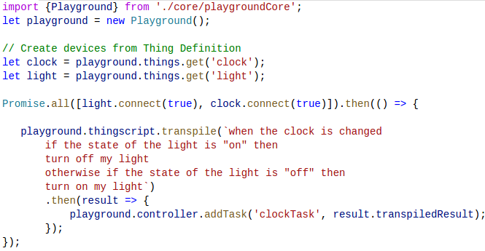
Managing The Internet of Things
Benjamin Romano
The University of Alabama
Abstract
Architecture
Thing Definition
As more devices are added to the Internet each day, controlling their interaction has become very challenging. The goal of this project is to create a software solution that will manage these connected devices and allow users to specify the meaning of the device interactions. To achieve this, we created software to handle device connections and a website to manage devices. In addition, we designed and implemented a domain-specific language to define the relationships between devices.
We created a hardware agnostic platform, Wendo, that runs on Node.js and is written in TypeScript. IoT devices and cloud services (Things) can connect to Wendo. Things tell Wendo what they are capable of doing by sending a Thing Definition File. Users can define interactions between Things by creating Tasks using ThingScript. Things notify Wendo when an event occurs and Wendo executes any Tasks that are triggered. Wendo can also dispatch actions to Things.
A Thing Definition contains all the relevant information to work with a connected Thing. This includes the following fields:
Display Name
Type (Physical or Cloud)
Actions
Events
Public Data
This information is sent to Wendo in a Thing Definition File (.tdef) which is written in JavaScript. Actions, Events and Public Data includes type info. This is necessary for type validation in the ThingScript compiler.
This template addresses layout structure in traditional academic poster presentations.
This is a short (50-100 word) summary of your research. Your abstract should be able to stand alone, completely self-contained. This section is 75 words at 28 point font. Your body text should be between 24 and 32 point font. This section is 75 words at 28 point font. Your body text should be between 24 and 32 point font.
Goals &
Research Methodologies
Wendo Playground
To help validate our system, we created the Wendo Playground. A library to quickly test ThingScript, Thing Definitions and devices. Developers can use the Playground to virtually simulate their devices as well as test their real devices.
Simplify integration of IoT devices into a user’s home
Allow users to create interactions between devices and cloud services without prior programming knowledge
Make it simple to add custom IoT devices to our platform
Create a platform that can run on any hardware
Used JavaScript due to popularity, ease of use and portability
Copied English sentence structure for ThingScript to lessen learning curve
ThingScript
ThingScript is a domain-specific language to define device interactions. ThingScript code is compiled into JavaScript. Valid ThingScript includes an event to fire on and a list of actions to perform once that happens. Conditionals, relational operators and mathematical operators are supported by ThingScript.
If (things.getThing("clock“)
.getData("time").getValue() === "evening") {
var __0 = {};
__0["brightness"] = 100 – things.getThing("light sensor")
.getData("level").getValue();
things.getThing("light")
.getAction("turnOn ").invoke(__0);
} else {
var __1 = {};
things.getThing("blinds")
.getAction("close").invoke(__1);
}
when the door is opened,
if the time of the day is evening then
turn on the light with brightness as 100 - the level of the light sensor
otherwise close the blinds
Using the Playground
ThingScript Input File
JavaScript Output File

