Slide 1
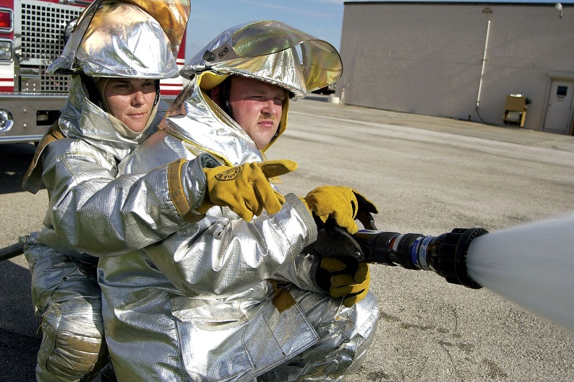
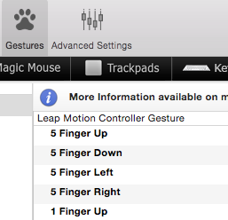
Robotic Navigation through Gesture Based Control
< RNGBC >
Nickolas McCarley University of Alabama
Abstract
Robotic Navigation through Gesture Based Control (RNGBC) assists people who may not be able to operate a smart device using their fingers. These individuals might face limitations due to physical disabilities or may be in a job where their fingers are not free to operate the smart device.
Sphero Code
The code below is used to operate Sphero movement using a computer instead of a phone.
Leap Integration
The Leap software is used to map the Leap Motion input to the computer. This software reads the users gestures and binds them to a command.
Conclusions
The current state of the project demonstrates the possibilities of using gesture-based control to operate transportation vehicles (e.g., a wheel chair) and machines in the workplace where the employees where gloves. Gesture technologies, such as those similar to this project, can assist those with disabilities and other limitations in performing common tasks.
The project also has the potential to generate interest in computer science with younger students who may find the technology fun to use, sparking their curiosity in how motions sensors and robots work. The Leap can be adapted to use gestures to control a variety of other robots..
Introduction
With an estimated 7.1 percent of Americans having an ambulatory disability there is a strong need to be able to operate technology with gestures [1]. RNGBC was made with this goal in mind. The Sphero and Leap Motion were used as the basic tools. RNGBC works by breaking the operation of the Sphero into simpler gestures for a user. Another problem faced by persons attempting to use standard input devices, could be the need to use gloves while performing a job task. Gloves used for protection in jobs like welding and firefighting could hinder the user from operating a touch screen while wearing the safety equipment. In these situations hand gestures might still be possible. RNGBC works so that the user does not have to use the keypad on a smart device such as a tablet or phone but they can operate the Sphero with only their hand gestures.
Bluetooth Connection
Sources
1. Cornell University. Disability Statistics. 2013. 19 September 2016
<https://www.disabilitystatistics.org/reports/acs.cfm?statistic=1>.
2. Leap Motion. Leap Motion. 20 September 2015
<https://www.leapmotion.com/>.
3. Pierce, David. A look inside Leap Motion, the 3D gesture control
that's like Kinect on steroids. 26 June 2012. 19 September 2015
<http://www.theverge.com/2012/6/26/3118592/
leap-motion-gesture-controls>.
4. Sphero Company. About Sphero. 18 September 2015
<http://www.sphero.com/sphero>.
5. —. Sphero SDK. 19 September 2015
<http://sdk.sphero.com/>.
6. All default Sphero code supplied via Orbotix inc and Michael DePhilllips
Leap Motion
The Leap Motion device can be connected to a computer in order to read hand motions that are made in a 3D space. The Leap can track the movement of the users hands and gestures indicated by the user. The Leap is also easily programmable and can be customized to recognize specific gestures from the user.
The software provided with the Leap motion allows the leap to recognize specific gestures from the user, such as raising a hand or moving said hand side to side. The Leap uses camera sensors to create a workspace that is approximately three cubic feet. The user can perform a wide array of gestures and the leap will recognize them and send the command to the laptop.
Sphero
The Sphero is a polycarbonate ball controlled by Bluetooth and can roll and change color. It is typically operated using a smartphone with an app that serves as a type of remote control. The Sphero can be modified and programmed. The goal of the RNGBC project is to provide a modality to interact with the Sphero in ways other than the smartphone app.

