Slide 1
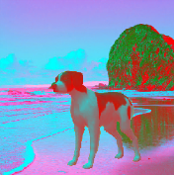
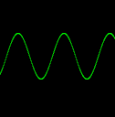
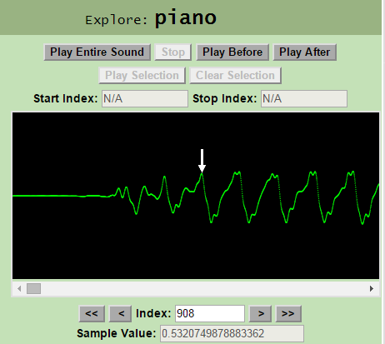
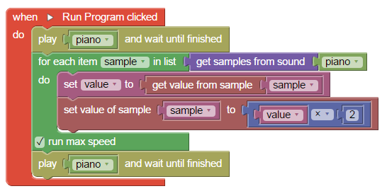
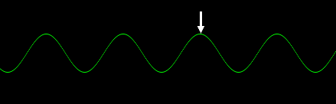
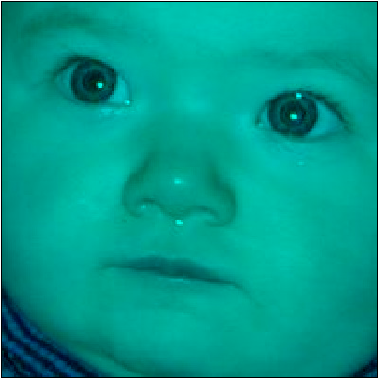
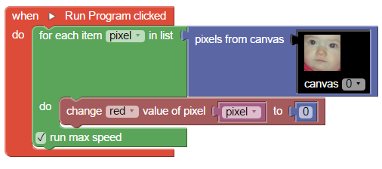
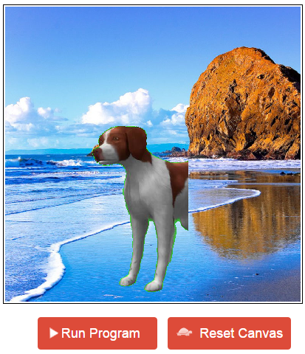
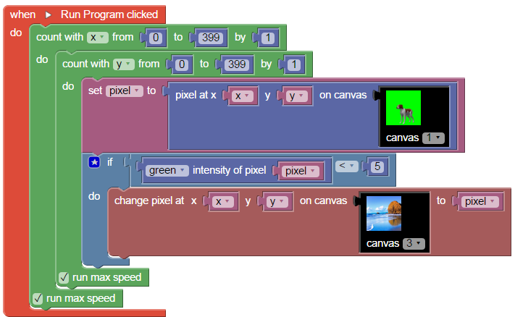
Web-based Visual Programming
for Media Computation using Blockly
Jake Trower (Advisor: Jeff Gray)
Department of Computer Science, University of Alabama
Abstract
Tunely: Sound Sample Manipulation
Myna Integration
Tunely and Pixly are web-based programming environments for media computation built using the Blockly visual programming library. These language environments were inspired by Georgia Tech’s Media Computation approach and allow images (Pixly) and sounds (Tunely) to be transformed programmatically. Tunely and Pixly provide an accessible environment to students who have little to no experience in programming. This SRC poster summarizes the design and implementation of these languages. We also briefly introduce initial work on providing an interface for children with disabilities to explore this opportunity.
Tunely [4] provides a visual user interface for the manipulation of sound samples. It provides default sounds, and provides means to upload sounds from the user’s computer. All sounds are represented by a sample/time graph that shows a visual representation of the digital structure of the sound.
Users may play the sound in its entirety through this “exploration” interface, or may select individual ranges on the sound samples to hear what parts of the sound they represent. In addition to the standard set of programmatic operations Blockly provides, Tunely has a set of programming components that return the sample list from a sound, allow values of individual samples from this list to be manipulated, and has blocks that allow the sound to be previewed before and after the manipulations.
Myna is a tool that provides a vocal user interface for programming by voice (PBV) to assist children with mobility disabilities in learning to program in Scratch [3].
Property files specific to Tunely and Pixly were created for Myna manually and using the “Myna Mapper” automatic property file tool [6].
When Myna is ran with specified property files, vocal commands can be used to navigate the Blockly environments.
Left: “exploration” interface which allows users to visualize a sound
Left: example Tunely program that plays a sound before and after doubling the volume of the sound (by doubling each sample value)
Conclusion
Background & Related Work
A high school computer science teacher who integrated Pixly into his class reported that its use has helped students understand nested loops to manipulate pixels in an image.
Future work on Tunely and Pixly include better tools for larger scale projects (picture collages and music composed of linked sound samples), and ways to integrate usage of the two applications.
Approaches to teaching media computation have so far primarily been reliant on textual programming languages [1]. For students new to computing, wrestling with the syntactical rules of implementing their ideas can be frustrating.
Pixly and Tunely provide concrete virtual language environments for pixel and sound sample manipulation. This gives students a visual representation of both the media they wish to manipulate and the programming components that allow them to transform these media resources.
Blockly is a library for building visual programming editors. Created by Google for Education, it is a pure JavaScript library that may be incorporated into web applications that wish to provide some sort of block programming application. Blockly provides the tools for custom block creation and has a number of basic programming components to support mathematical operation, variable and function creation, list and string manipulation, etc. Programs created in Blockly can be translated into corresponding JavaScript (or Python or some other language) code. Blockly was influenced by App Inventor, which was in turn influenced by Scratch [2].
Pixly, along with another Blockly application Spherly, was presented at the SIGCSE 2015 Technical Symposium as a demonstration and undergraduate poster: the focus then was more on using Blockly to create visual block languages. Pixly has since been updated and Tunely was created to expand web based visual programming media computation opportunities.
Left & Above: example snippet that generates a sinewave (by calculating the appropriate sample values) and plays it.
Pixly: Pixel Manipulation
References
Pixly [5] provides an environment for students to practice media computation [3] (in particular, pixel manipulation of images). Using custom Blockly blocks, users can iterate through and manipulate the RGB values of the pixels of an image.
Pixly has, in addition to the standard set of programmatic operations Blockly provides, a set of blocks that allow users to obtain a list of pixels from an image, get the red, green, and blue values from each of these pixels, and set any of these values for any given pixel.
[1] Media Computation Teacher’s Website, http://coweb.cc.gatech.edu/mediaComp-teach
[2] Blockly, https://developers.google.com/blockly/about/faq
[3] A. Wagner and J. Gray, “An Empirical Evaluation of a Vocal User Interface for Programming by Voice,” International
Journal of Information Technologies and Systems Approach
(Special Issue on Human-Computer Interaction, Carina
Gonzalez, editor), vol. 8, no. 2, May 2015, pp. 47-63.
[4] Tunely Website, http://outreach.cs.ua.edu/tunely/
[5] Pixly Website, http://outreach.cs.ua.edu/pixly/
[6] A. Wagner and J. Gray, “Improving the Accessibility of Block-Based Languages,” Poster session presented at: Blocks and Beyond, Oct 2015, Atlanta, GA.
Left: example Pixly program illustrating manually setting a pixel RGB value.
Results in baby picture losing all redness
Right: example chromakey program that iterates through one canvas and copies “non-green” pixels onto another canvas
Acknowledgements
This work was sponsored in part by NSF awards #117940 and #1240944
Also sponsored by Google CS4HS

