Slide 1



Creating Visual DSMLs from End-User Demonstration
Models in Software Engineering Workshop
Zurich, Switzerland
June 2, 2012
Hyun Cho, Jeff Gray, and Eugene Syriani
University of Alabama
Department of Computer Science
This work supported in part by NSF CAREER #1052616.

Slide 2
End-User and Domain Expert Sketching
Please see Marian Petre’s MODELS 2011 keynote for various examples…
Reused with permission. MoDELS 2011 Keynote presented - Marian Petre

Slide 3
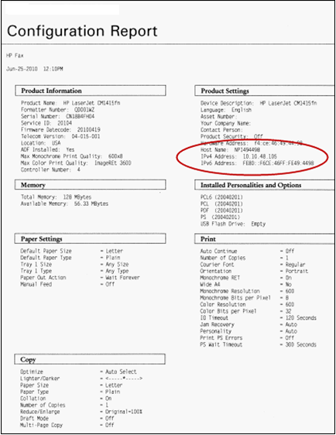
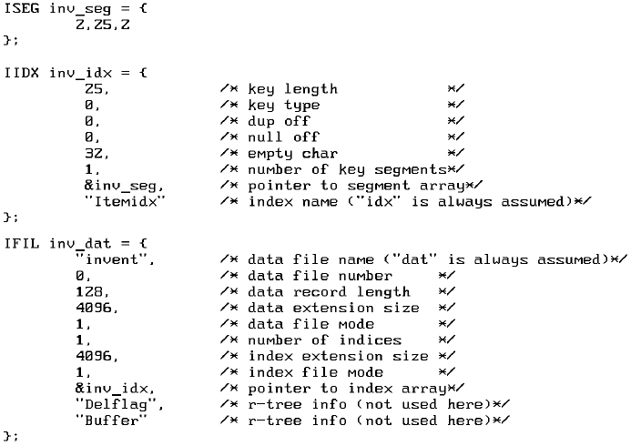
DSML Example: Printer Configuration Report
Predefined font
void draw_report(BITMAP *bmp,int x,int y) {
int j;
word screen_offset = (y<<8)+(y<<6)+x;
word bitmap_offset = 0;
for(j=0;j<bmp->height;j++) {
memcpy(&VGA[screen_offset],
&bmp->data[bitmap_offset],bmp->width);
bitmap_offset+=bmp->width;
screen_offset+=SCREEN_WIDTH;
}
}
Design the report specifying the font and location manually

Slide 4
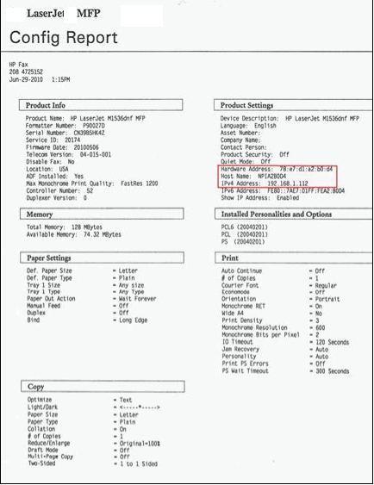
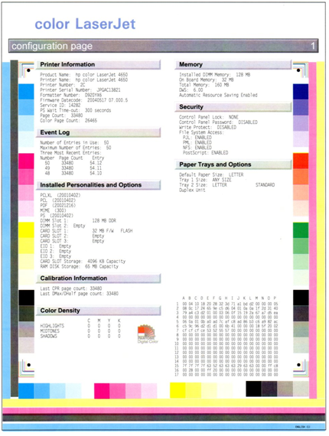
DSML Example: Printer Configuration Report (cont.)
Notes:
The report designers can handle implementing the report form manually, but have to handle several reports that have similar structures but different items, or different decoration such as report form for color printer

Slide 5
DSML Example: Printer Configuration Report (cont.)
Development Phase
As-Is
To-Be
WYSIWYG report form design tool
Report form design
Design report form manually using paper
Specify function to get configuration information
Hard code font and location correspond to the report form
Generate source code from the form
Report form Implementation
Insert function to get Configuration Information
Require visual report design language for Printer domain

Slide 6
Research Goal
Language elements can be (semi)automatically derived using machine learning techniques by applying those techniques on a set of user demonstrated example domain models. We aim to assist domain experts, who do not have program language development expertise, to create their own DSMLs.
The idea borrows from our earlier work in two areas: 1) Model-Transformation by Demonstration, which was influenced by other “By Example” approaches; and 2) Metamodel inference from existing examples, which was influenced by grammar inference research.

Slide 7
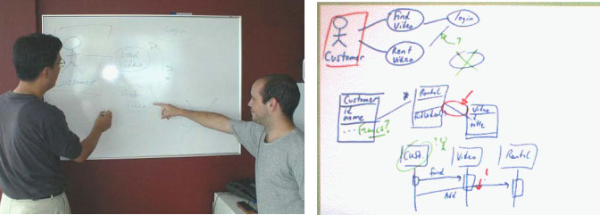
DSML Development Challenge 1
Preference for unconstrained environments
  Design with whiteboard, papers, or computer with pen-based input; provides flexibility in processing a wide range of open notations for different domains
  Easy to capture high-level requirements and communicate with participants interactively from the same domain
  Documents are informal and often not documented
Figures are excerpted from Chen, Q., Grundy, J.C., and Hosking, J.G. SUMLOW: Early Design-Stage Sketching of UML Diagrams on an E-whiteboard, Software – Practice and Experience, vol. 38 , no. 9, Wiley, July 2008, pp. 961-994

Slide 8
DSML Development Challenge 2
Developing a DSML often requires familiarity of
domain knowledge and
language design expertise
Domain
Experts
Programming Language Development Experts
Quality of Domain Understanding
Quality of DSML Implementations & Maintenance
Experts who have both domain knowledge and language development expertise

Slide 9
DSML Development Challenge 3
Complexity of DSML development
  DSML development is often iterative and incremental
    Several different stages are often used to develop a DSML
    Helps to capture and formalize constantly changing requirements and notations
    Can be tedious, error-prone, and time-consuming without tool support
Identify abstract syntax
Identify concrete syntax
Initial requirements for domain models
Evaluate and feedback
Specify associated semantics
DSML for a domain

Slide 10

DSML Development Challenge 4
Static Semantics
- Attribute grammar
Dynamic Semantics
Operational Semantics
Axiomatic Semantics
Denotational Semantics
Choosing an appropriate technique for semantics specification is not easy
Formal specification of modeling language semantics is challenging even for language designers

Slide 11
Proposed Resolution of the Challenges
Challenge 1
  Preference for unconstrained environment
Resolution 1
  Use flexible modeling tool that supports sketch-level modeling
Challenge 2
  Familiarity of domain knowledge and language design expertise
Resolution 2
  Provide DSML development environment that can develop DSML without language design expertise
Challenge 3
  Complexity of DSML development
Resolution 3
  Simplify DSML development through automation; inference from user-driven examples
Challenge 4
  Formal specification of modeling language static semantics
Resolution 4
  Infer the static semantics from DSML model instances
DSML Creation By Demonstration

Slide 12
Modeling Language Creation By Demonstration Process

Slide 13
MLCBD Process: Concrete Syntax Identification
Model (or Demonstrate) a domain using domain modeling tool
  The tool provides predefined shapes and supports users in defining new shapes
Capture domain model elements (or concrete syntax) while users demonstrate the domain model
  Identify unique modeling elements and their structural pattern
Identify concrete syntax through Annotation
  Review unique modeling elements and relevant modeling element instance names
  Naming each unique modeling elements & setting properties of relationships

Slide 14
Demonstrated models and Concrete Syntax
Domain: Simple Image Processing
A set of domain models created by user demonstration
Candidate concrete syntax captured automatically while user demonstrates the domain
Confirmed concrete syntax by user annotation

Slide 15
MLCBD Process: Model Transformation
Transform domain models into abstract models using graphs
  A set of domain models may be maintained under XML files
  Mismatch in representation expected by inference techniques
Graph transformation can assist in the creation, editing, analysis, and execution of visual programs
Notes:
Graph Grammar Induction on Structural Data for Visual Programming, Keven Ates, Jacek Kukluk, Lawrence Holder, Diane Cook, Kang Zhang

Slide 16
MLCBD Process: Model Transformation
Graph Builder transforms a set of domain model examples into a set of undirected graphs as well as dependency/cardinality matrix
Cardinality Matrix
Notes:
Initially, the cardinality matrix sets to 0.
When (a) is presented, cardinality between StartState and EndState is set to 1
When (b) is presented, cardinality between StartState and EndState is changed to 0,1 because StartState is linked to Read instead of to EndState.
In addition, cardinality between StartState and Read is also set to 0,1 because StartState can be linked to either EndState or Read.
But Cardinality between Read and StartState is 1 because Read is always connected to StartState
Similarly, cardinality between EndState and StartState, Read, Write is 0,1 because EndState can be linked any of them.
Finally, cardinality between Write and other states, and between Rotate and other states are 1 because the other states are always shown together when Write and Rotate is presented. However, the cardinality can be changed if more models are presented

Slide 17
MLCBD Process: Model Transformation (cont.)
Graph Annotator rewrites a set of graphs, which is created by the Graph Builder, based on the annotation
Step1: Rewrite based on relationship attribute, directionality

Slide 18

MLCBD Process: Model Transformation (cont.)
Graph Annotator optimizes graphs by removing identical syntax
Step 2: Based on the syntax attribute; collapsing common classifiers

Slide 19
MLCBD Process: Abstract Syntax Inference
Infer abstract syntax (i.e., metamodel) based on abstract domain models, especially structural patterns of graph
Process may be considered a special case of inductive learning
Metamodel Design Patterns are used as training data for metamodel inference
Notes:
Graph-based machine learning technique with a small set of training data

Slide 20
Metamodel Inference from demonstrated examples
Make the cardinality matrix from the graph representation of a set of domain models
 | StartState | State | EndState
StartState |  | 0, 1 | 0,1
State |  | 0, * | 1
EndState
Calculate the number of unique nodes in the graphs
  Each node corresponds to classifiers
  The number of unique nodes in this example is 3
Notes:
As a state can be linked to many other states, cardinality between States is 1.
However, cardinality between State and EndState is 1 because State is linked to EndState whenever State is presented

Slide 21
Metamodel Inference Using Metamodel Design Patterns
Create a set of metamodel instances and the cardinality matrix
  The number of classifiers participating to create a set of metamodel instances will be less than or equal to the number of unique nodes in the graph
Base metamodel design pattern
 | Classifier1 | Classifier2 | Classifier 3
Classifier1 |  | 1 | 0,1
Classifier2 |  | 0,1 | 0,1
Classifier 3

Slide 22
Metamodel Inference Using Metamodel Design Patterns
Create a dependency matrix of metamodel instances
Create a decision tree based on row-column representation of the dependency matrix
Each leaf node in the decision tree represents exactly one dependency matrix
Tree depth = the number of row-column representation of the dependency matrix
Identify matching branch by traversing the decision tree with the user demonstrated models.

Slide 23
Metamodel Inference Using Design Patterns (cont.)
Graph and Dependency Matrix
Row-Column Representation
Decision Tree
Notes:
Get the value of first index in row-column representation
Check the tree whether the branch labeled with value
If there is no branch, create a new branch and label with the row-column representation
If there is branch, check there is next available value in row-column representation
If there is no next available value, check there is next available row-column representation
If there is next available row-column representation, get next row-column representation and move next node in decision tree
If there is no next available row-column representation, exit decision tree creation routine
If there is next available value, get the next value in row-column representation
Continue step 2 and 6.
With the dependency table in above
Branch labeled 0 is created.
Get the second row-column representation (1,0,0), create another branch under branch labeled 0.
Get the third row-column representation (1,1,0,0,0), create another branch under branch labeled (1,0,0).
With the dependency table in bottom
Get the first row-column representation, do nothing and move next node because branch labeled 0 and no next item available.
Get the second row-column representation, get the second value of row-column representation because there is a branch starting with the first value
Create a new branch because there is no branch matched.
Get the third row-column representation, and create a new branch.

Slide 24
Static Semantics Inference
Goal: Infer static semantic constraints from abstract domain models and associate with inferred metamodel
Focus on identifying static constraints from domain models

Slide 25
Examples of Constraints
Offen, R. (2000). CASE Tools and Constraints. North Ryde: Macquarie University Joint Research Centre for Advanced Systems Engineering.
Process Modeling
  A DFD either must be a context diagram or have a parent process on a higher-level DFD
  A parent process must be specified before its child processes
  External entities must be connected only to a process
  Each data store on a set of DFDs must be uniquely named
Data Modeling
  Entity must be specified before its relationship
  Entity and relationship must be specified before their attributes
  Cardinality must be shown at each end of a relationship
  Associative entities must have one or more attributes
Event Modeling
  All states shown must be attainable
  Final state in lower-level diagram must correspond to exit in associated higher-level state
  Only one start state may be placed in each diagram
  Every diagram must have a start state and a final state
Class Modeling
  Unidirectional associations cannot be drawn between a class and a package or a node
  An association cannot be drawn between a package and an actor
  An aggregation cannot be drawn between a parameterized class utility and a node
  A generalization cannot be drawn between a parameterized class utility and a use case or a node

Slide 26
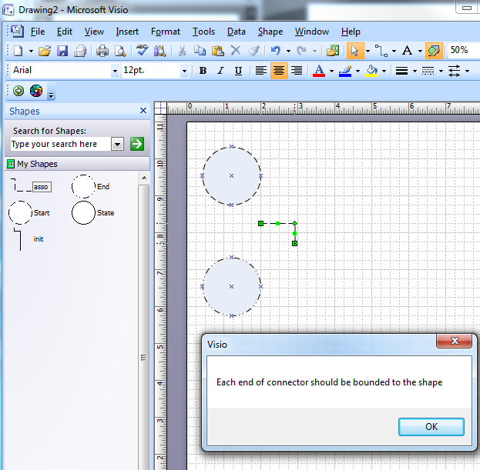
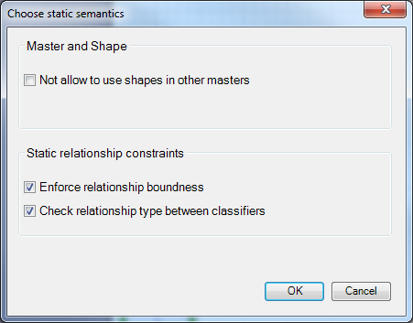
Screenshots of Relationship Constraints

Slide 27
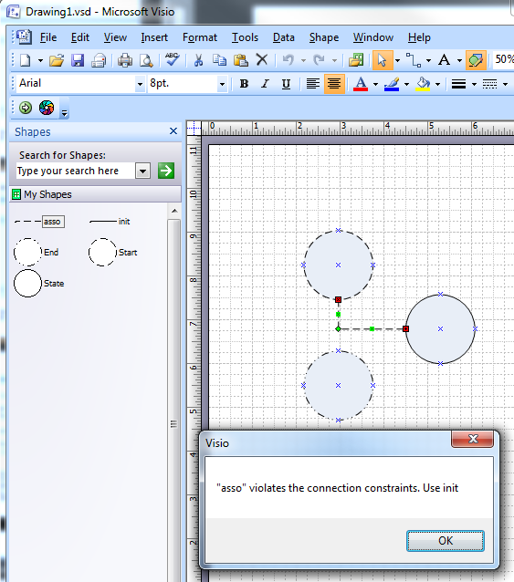
Screenshots of Relationship Constraints (cont.)
Relationship constraints
Use relationship “init” between Start and State, State and End
Relationship “asso” is allowed between states

Slide 28
Future Work
Metamodel export
  The current metamodel is internalized and used to generate the Visio templates and Visual Basic scripts
  Potential to generate metamodel in other formats for different metamodeling environments
Extend beyond a constrained sketching tool
  Potential to describe generators and transformations from a demonstration approach
  Integrate with Model Transformation by Demonstration tools
Evaluation
  Experimental Evaluation, including human-based studies

Slide 29
Discussion and Future Evaluation Needs
Generality
  Complexity of DSMLs and the number of DSML constructs is different for each DSML
  The proposed approach can build DSMLs for many types of DSMLs
  Evaluate by considering approach for numerous types of DSMLs
Accuracy
  Abstract and Concrete Syntax are inferred from a small set of domain model examples
  Inference with a small set of training data is challenging
  Evaluate by correctly instantiated domain models from the inferred metamodel
Simplicity
  If a DSML is large and complex, its metamodel may also be large and complex, and can have unnecessary complexity
  The inferred metamodel needs to be as concise and simple as possible
  Evaluate by comparing number of elements between inferred metamodel and referred metamodel

Slide 30
Summary
This presentation introduces a way to develop a DSML through a machine learning approach, so that general end-users can assist in designing a DSML by providing concrete examples
  Flexible modeling environments supports modeling domains with user-defined modeling elements
  Machine learning techniques can help domain users to create their own DSMLs without programming language development expertise
  Metamodel design patterns may help to infer accurate metamodel even though a small set of training data is provided

Slide 31
Demonstration
Finite State Machine
  Demonstrate a FSM language
  http://www.cs.ua.edu/graduate/hcho7/demo/createTemplate.wmv
  Create new FSM model using the created FSM language
  http://www.cs.ua.edu/graduate/hcho7/demo/createNewModel.wmv
Network Modeling Language
  Demonstrate a Network Modeling Language
  http://www.cs.ua.edu/graduate/hcho7/demo/createTemplateForNetwork.wmv
  Create new Network Model using the created Network Modeling Language
  http://www.cs.ua.edu/graduate/hcho7/demo/createNewModelForNetwork.wmv

Slide 32
Shameless Plug
12th Edition of Domain-Specific Modeling Workshop at SPLASH/OOPSLA
  More details coming soon at:
  http://www.dsmforum.org/events/DSM12/

Slide 33

Thank you for your attention
This work supported in part by NSF CAREER #1052616.

