Slide 1



A DEMONSTRATION-BASED APPROACH FOR
DOMAIN-SPECIFIC MODELING LANGUAGE CREATION
Committee:
Dr. Jeff Gray (Chair)
Dr. Barrett Bryant
Dr. Jeffrey Carver
Dr. Marjan Mernik
Dr. Randy Smith
Dr. Eugene Syriani
Hyun Cho
University of Alabama
Department of Computer Science
This work supported in part by NSF CAREER #1052616.
Notes:
I really appreciate what you have done for me.

Slide 2
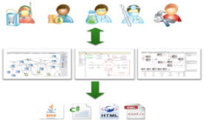











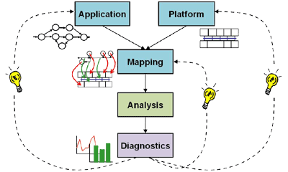
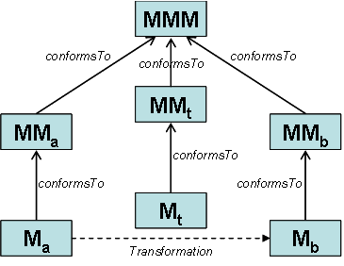

Roadmap
Background
Domain-Specific Modeling Languages (DSMLs)
Research Objectives
Semiformal Requirements Modeling
User-Centered & Flexible Modeling
Automate DSML Development
Automate DSML Verification
Approaches
Intermediate Deign Space
Model Space Exploration
Syntax Map

Slide 3
Domain-specific modeling languages

Slide 4
Domain-Specific Modeling Languages
High-level modeling languages specific to a particular application or set of tasks
Generally, tries to replicate syntax common to users of that domain
Narrow down the design space
Focus on single range of products
General
Purpose
Domain
Specific

Slide 5
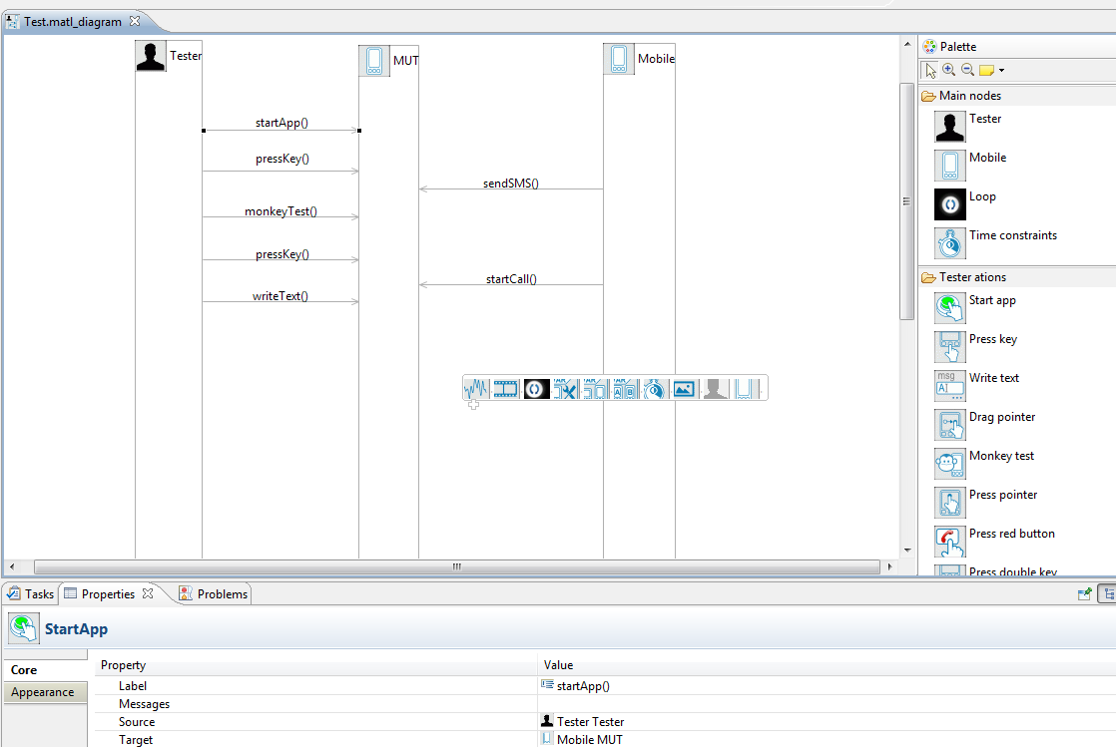
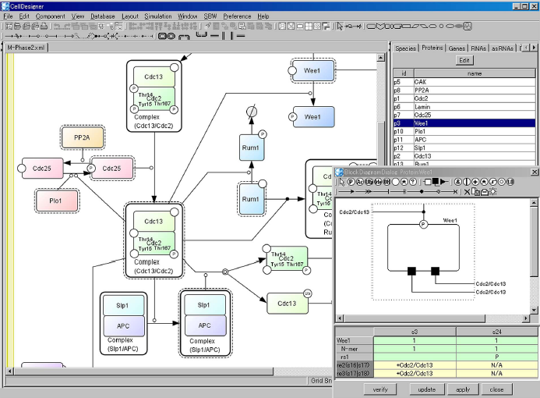
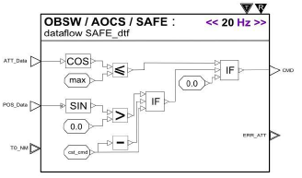
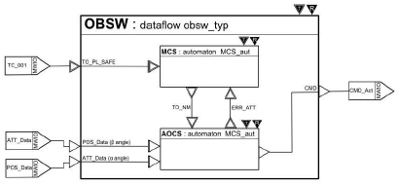
Domain-Specific Modeling Languages (DSMLs)
Example DSMLs
Mobile Phone Application Testing
Biochemical Network Design
On-Board Real-Time SW Design
Notes:
Mobile phone application testing
Cell Designer: DSML for Biochemical Networks
Synoptic: On-board real-time sw design

Slide 6
Advantages of DSML
DSMLs can be used by domain experts who may not be computer scientists
Models expressed in a DSML are often:
  Expressive and concise
  Can be written quickly
  Maintainable
  Easier to reason about
May support improved productivity
Addresses top cost of SW
Transformation and verification
DSMLs can help to span the differences in the problem space (domain expert) from the technical solution space (computer scientist).

Slide 7
DSML Development challenges

Slide 8
DSML Development Challenge
Often requires familiarity of
domain knowledge and
language design expertise
Domain
Experts
Programming Language Development Experts
Quality of Domain Understanding
Quality of DSML Implementation & Maintenance
Increase development cost
Develop Inaccurate DSML due to miscommunication
Experts who have both domain knowledge and language development expertise
Marjan Mernik, Jan Heering, and Anthony M. Sloane, “When and How to Develop Domain-Specific Languages,” ACM Computing Surveys, vol. 37, no. 4, December 2005, pages 316-344.

Slide 9
DSML Development Challenge (cont.)
Complexity of DSML development
  DSML development is often iterative and incremental
    Several different stages are often used to develop a DSML
    Helps to capture and formalize constantly changing requirements and notations
    Can be tedious, error-prone, and time-consuming without tool support
Define abstract syntax
Define concrete syntax
Initial requirements for domain models
Evaluate feedback
Specify semantics
DSML for a domain

Slide 10
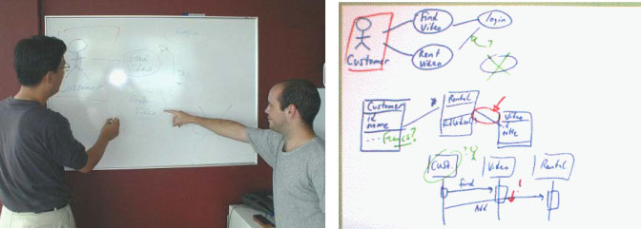
DSML Development Challenge (cont.)
User Preference for unconstrained environments
  Design with whiteboard, paper (“back of the envelope”), or computer with pen-based input system
  These contexts can process a wide range of free-form shapes for different domains
  Easy to access and communicate with participants interactively
  Documents are informal and often not documented
Figures are excerpted from Chen, Q., Grundy, J.C., and Hosking, J.G. SUMLOW: Early Design-Stage Sketching of UML Diagrams on an E-whiteboard, Software – Practice and Experience, vol. 38 , no. 9, Wiley, July 2008, pp. 961-994
Notes:
First of all, a whiteboard is visual. And it’s BIG. You can see at a glance how things are going.
A whiteboard is also flexible.
It’s fast and efficient to change
It’s also more tactile.
It’s also novel. When a team starts doing agile – and they create great visibility using the whiteboard – it’s remarkable how many people want to come and look.
Important information can be highlighted easily by putting it on the whiteboard.
And last but not least, the unstructured nature of the whiteboard allows it to be personalized by the team. The team can express itself through the things it puts on its whiteboard. It starts to show the character of the team, and therefore helps to create a visible sense of team spirit.

Slide 11
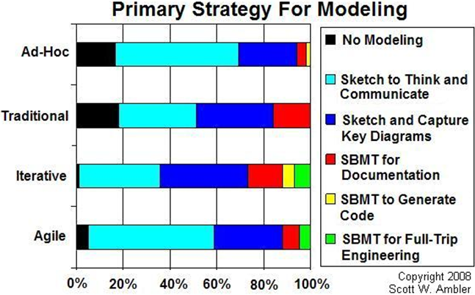
DSML Development Challenge (cont.)
Modeling and Documentation Survey
  by Scott Ambler (July 2008)
  Message sent out to Dr. Dobb's Journal mailing list and advertised on www.ddj.com
  279 respondents
Figure is excerpted from http://www.agilemodeling.com/essays/whiteboardModeling.htm

Slide 12
Goals of the Research
Allow end-users to create DSMLs
Automate several steps of DSML development
Support predefined, free-from shapes and/or image files
Allow domain expert to verify the created DSML
Describe language requirements precisely and concisely
Intermediate Design Space
Flexible Modeling
Model Space Exploration
Syntax Map
A Demonstration-Based Approach for
Domain-Specific Modeling Language Creation
Notes:
So, to address DSML development challenges, the research aims

Slide 13
Overall Process
Modeling Language Creation By-Demonstration (MLCBD) Framework
Syntax Map
Intermediate Design Space
Model Space Exploration
Modeling Requirements of a DSML
Demonstrate domain
notions
Identify
Concrete Syntax
Infer Metamodel
Infer Semantics
Generate Model Space
Explore and Cluster
Verify the inferred metamodel and semantics
Feedback to update DSML requirements
Feedback to update metamodel and semantics
Scenario-based
Graphical requirements modeling
By-Demonstration technique
Metamodel design patterns
Graph and its transformation
Grammatical Inference
Semantics Inference (Static constraints)
Graph Traversal
(s-t path finding)

Slide 14
Syntax Map:
DSML Requirements modeling

Slide 15
Syntax Map: Semi-Formal DSML Requirements Model
Graphical modeling language for capturing and managing requirements of DSMLs
Scenario-based requirements capturing
  Modeling according to causal relationships between responsibilities of one or more classifiers and relationships
Convey a lot of information in a compact form
Enable reasoning about missing or redundant components of a DSML
Hyun Cho, Jeff Gray, and Eugene Syriani, Syntax Map: A Modeling Language for Capturing Requirements of Graphical DSML, The 19th Asia-Pacific Software Engineering Conference, Hong Kong, Dec 2012.

Slide 16
Syntax Map Notations

Slide 17
Benefits of Syntax Map
Syntax Map can describe requirements of a DSML semi-formally and may minimize miscommunication between stakeholders
Syntax Map can be used to verify requirements of a DSML by checking conflicted usage scenarios
Syntax Map can be used to generate preliminary syntax and static constraints of a DSML

Slide 18
Intermediate design space

Slide 19
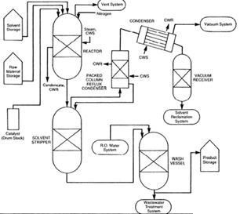
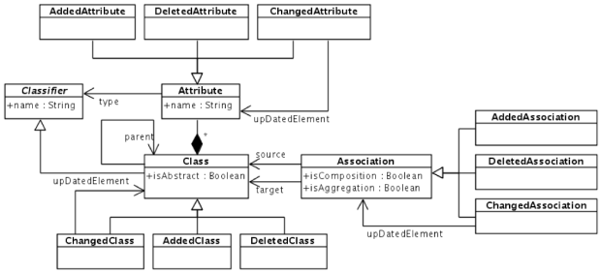
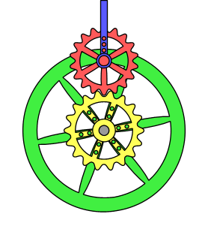
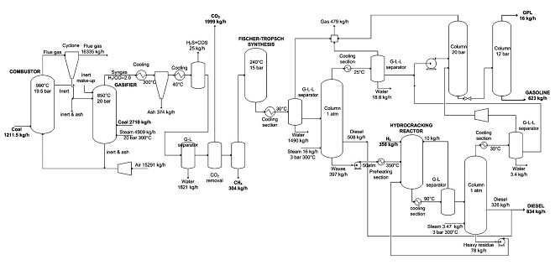
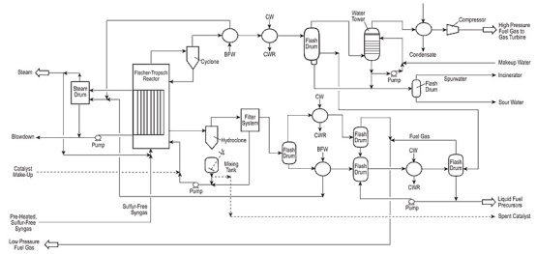

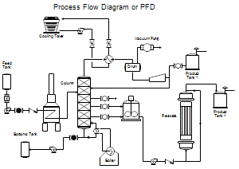
Intermediate Design Space
A Modeling Language
Inference Engine
Domain Experts
A set of domain model examples

Slide 20
Intermediate Design Space (cont.)
Create a DSML from a set of domain model examples using inference and graph transformation
Transform a set of domain model examples into attributed graphs
  Make inference engine independent from representation of input models
  Find candidate concrete syntax
  Find primitive domain models that have minimal notions
Infer metamodel and static constraints from a set of attributed graphs

Slide 21
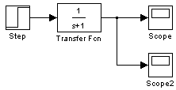



Domain Models for Process Control
Continuous process for mass productions
  For example, oil refinery, power plants, and chemical factories
Notes:
Step : A signal that shows zero for negative and one for positive
Gain: Amplifies an input signal by a given factor.
Scope : A sink block used to display a signal much like an oscilloscope
Adder : Generates a signal by adding two input signals
Transfer Fcn : Modifies its input signal and produces a new signal as output
Link : Flow of signals

Slide 22




Candidate Concrete Syntax
Capture unique modeling elements while domain experts demonstrate notions of their domain
Symbol | Name | Label
 | Step
 | Gain | 2.5
 | Scope, Scope2
 | Transfer Fcn, PI Controller, Plant

Slide 23
Annotated Concrete Syntax
Assign domain terms to candidate concrete syntax
Define attributes if necessary
Symbol | Name | Attributes
 | Step | Type := classifier Name := String
 | Gain | Type = classifier Name := String Gain := Double
 | Scope | Type = classifier Name := String
 | Adder | Type = classifier
 | Transfer Fcn | Type = classifier Name := String Numerator := String Denominator :=String
 | Link | Type = Relationship Directional = yes

Slide 24
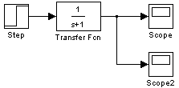
Graph Transformation
Combined with Concrete Syntax

Slide 25
Graph Representation (cont.)

Slide 26
Combined Graph Representation
Des Src | Step | Adder | Gain | Transfer Fcn | Scope
Step | 0 | 1 | 0 | 0 | 1
Adder | 0 | 0 | 1 | 0 | 0
Gain | 0 | 0 | 0 | 1 | 0
Transfer Fcn | 0 | 1 | 0 | 1 | 1
Scope | 0 | 0 | 0 | 0 | 0
Des Src | Step | Adder | Gain | Transfer Fcn | Scope
Step | 0 | 0,1 | 0 | 0,1 | 1,2
Adder | 1,1 | 0 | 1,1 | 0 | 0
Gain | 0 | 1,1 | 0 | 1,1 | 0
Transfer Fcn | 0,1 | 0,1 | 0,1 | 0,1 | 1,2
Scope | 1,1 | 0 | 0 | 1,1 | 0
Adjacency Matrix
Cardinality Matrix
Notes:
Adjacency matrix and cardinality matrix will be used to

Slide 27
Metamodel Inference
Instantiate a set of models from Metamodel Design Patterns

Slide 28
Metamodel Design Patterns
Extend the notion of design pattern to metamodel design
Motivation
  Metamodels can be designed (or inferred) by reusing existing metamodel concepts that represent commonly recurring metamodel design issues across multiple domains
Expected benefits
  Avoid duplication of metamodel design for recurring design problems
  Keep high quality metamodel fragments
  Guide key patterns and best-practices of metamodel design
Hyun Cho and Jeff Gray, “Design Patterns for Metamodels,” 11th Workshop on Domain-Specific Modeling, Portland, OR, October 2011.

Slide 29
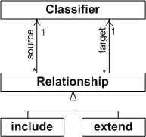
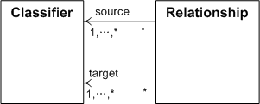
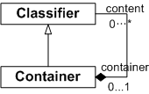
Metamodel Design Patterns (cont.)
Base Metamodel Design Pattern | (sub)Types Metamodel Design Pattern | Containment/Nesting Metamodel Design Pattern
Applicable for simple Box-and-Line style DSMLs Most common pattern for early stage of DSML development Useful for Prototyping DSML | Extension of base metamodel design pattern Add more expressiveness to DSMLs Semantics of each relationship is required to enforce behaviors and properties | Reuse composite pattern to express containment/nesting

Slide 30
Metamodel Inference (cont.)
Instantiate a set of models from Metamodel Design Patterns
Create a decision tree using row-column representation of each instantiated model
  Each leaf node in the decision tree represents exactly one adjacency matrix
  Tree depth = the number of row-column representation of the adjacency matrix

Slide 31
Decision Tree
Graph and Adjacency Matrix
Row-Column Representation
Decision Tree
Notes:
Get the value of first index in row-column representation
Check the tree whether the branch labeled with value
If there is no branch, create a new branch and label with the row-column representation
If there is branch, check there is next available value in row-column representation
If there is no next available value, check there is next available row-column representation
If there is next available row-column representation, get next row-column representation and move next node in decision tree
If there is no next available row-column representation, exit decision tree creation routine
If there is next available value, get the next value in row-column representation
Continue step 2 and 6.
With the dependency table in above
Branch labeled 0 is created.
Get the second row-column representation (1,0,0), create another branch under branch labeled 0.
Get the third row-column representation (1,1,0,0,0), create another branch under branch labeled (1,0,0).
With the dependency table in bottom
Get the first row-column representation, do nothing and move next node because branch labeled 0 and no next item available.
Get the second row-column representation, get the second value of row-column representation because there is a branch starting with the first value
Create a new branch because there is no branch matched.
Get the third row-column representation, and create a new branch.

Slide 32
Metamodel Inference
Instantiate a set of models from Metamodel Design Patterns
Create a decision tree using row-column representation of each instantiated model
  Each leaf node in the decision tree represents exactly one adjacency matrix
  Tree depth = the number of row-column representation of the adjacency matrix
Identify matching branch by traversing the decision tree with the user demonstrated models
Combine row-column representations to generate metamodel
Specify cardinality of relationship based on cardinality matrix

Slide 33
model space exploration

Slide 34

Model Space Exploration
A Modeling Language
Explore Model Space
Domain Experts
A set of domain model examples

Slide 35
Model Space Exploration
Extend the notion of Design Space Exploration
  Search through the large design space to find design alternatives that satisfy a given set of constraints and that are optimal with respect to one or more objectives
Applied to verify the inferred metamodel and static constraints
Applied to find missing notions
  Domain experts may not demonstrate enough examples to infer accurate metamodel and static semantics
  Demonstration may be tedious and time-consuming

Slide 36
Model Space Exploration (cont.)

Slide 37
Model Space Modeling
Create Positive Model Instances
Find s-t paths from the combined graph representation
Instantiate models from the s-t paths while referring to the cardinality matrix
Label expected validity of instantiated models by checking conformance to inferred metamodel and static constraints
Present the instantiated models to domain experts for reviewing and annotating
Create Negative Model Instances
Transpose the combined graph representation
Continue from 1 to 4

Slide 38






Model Space Modeling (cont.)
Model Instances
Created From
Positive Graph
Positive Graph
Positive Graph
Positive Graph
Positive Graph
Negative Graph
Expected Answer
True
True
True
True
True
False

Slide 39
Model Space Clustering
Model Instances
Created From
Positive Graph
Positive Graph
Positive Graph
Positive Graph
Positive Graph
Negative Graph
Expected Answer
True
True
True
True
True
False
User Answered
False
False
False
False
True
True

Slide 40
Case Study and Evaluation

Slide 41
Development of Network Diagramming Tool
Examples of a Network Diagram
Sub-layer Model
Top-layer Model

Slide 42
Development of Network Diagramming Tool (cont.)
Syntax Map

Slide 43
Comparison of DSML Creation
The following slides explain how a DSML is created using two approaches on the Network Diagram DSML
  Traditional metamodeling with the
  Generic Modeling Environment (GME)
  Using MLCBD to demonstrate core language concepts
Comparison is made between the two approaches in the areas of complexity, completeness, analysis, and language evolution

Slide 44
Traditional Metamodeling: GME

Slide 45
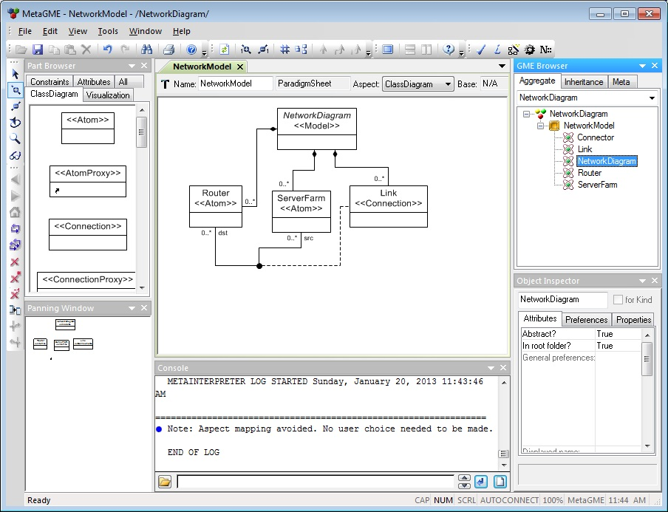
Development of Network Diagramming Tool with GME
GME (Generic Modeling Environments)
  Developed and maintained by Institute for Software Integrated Systems at Vanderbilt University
  An integrated DSML development environment
  Require knowledge about metamodeling and GME-specific modeling concepts
Model Browser
Part Browser
Model Edit Window
Attribute Browser
Console

Slide 46
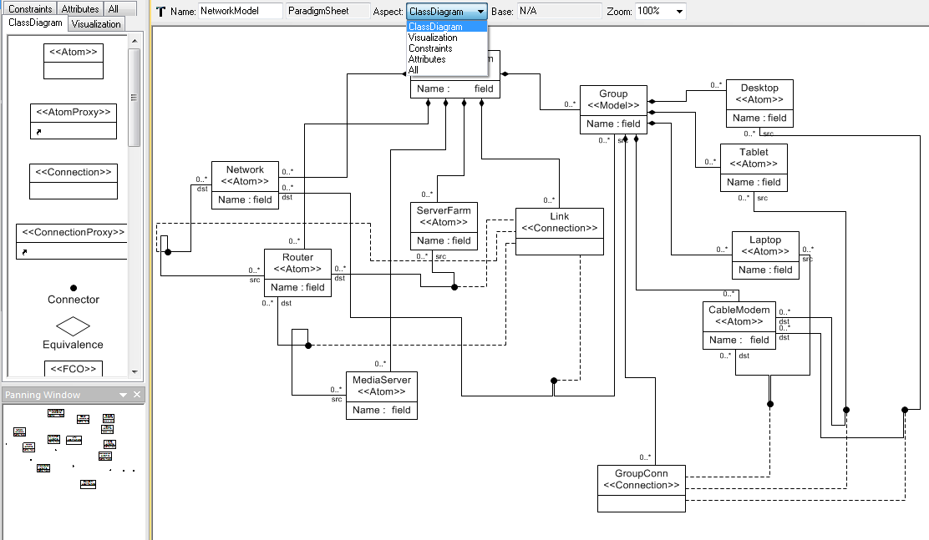
Development of Network Diagramming Tool with GME (cont.)
Metamodel Definition

Slide 47
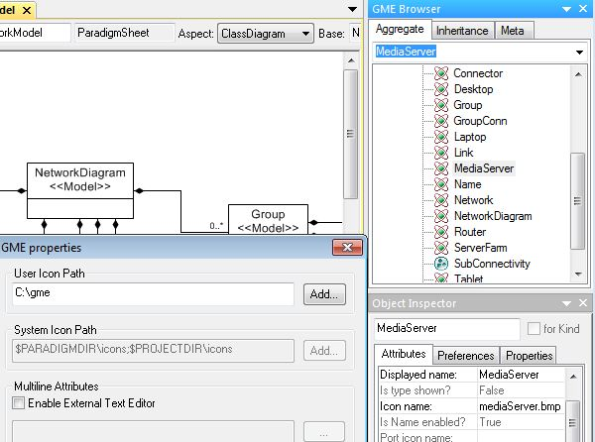
Development of Network Diagramming Tool with GME (cont.)
Concrete Syntax Specification

Slide 48
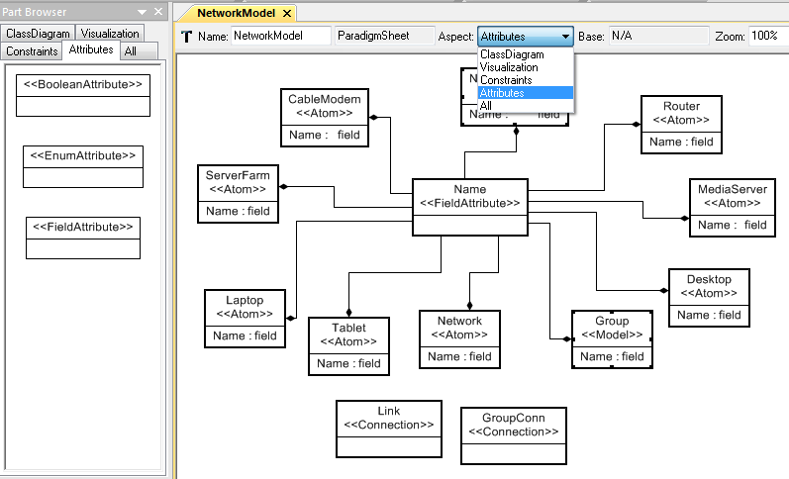
Development of Network Diagramming Tool with GME (cont.)
Attribute Specification

Slide 49
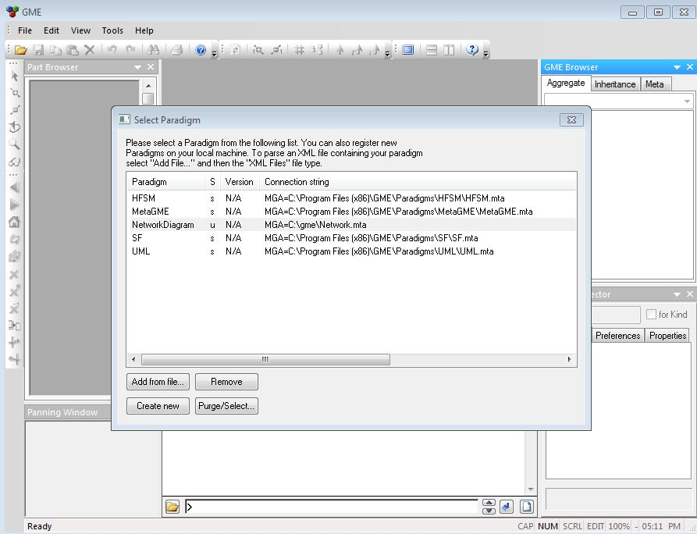
Development of Network Diagramming Tool with GME (cont.)
Creating a new Network Diagram

Slide 50
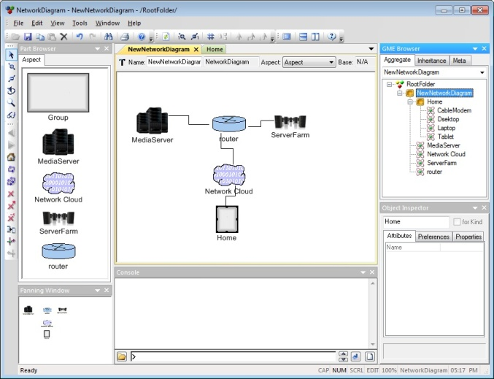
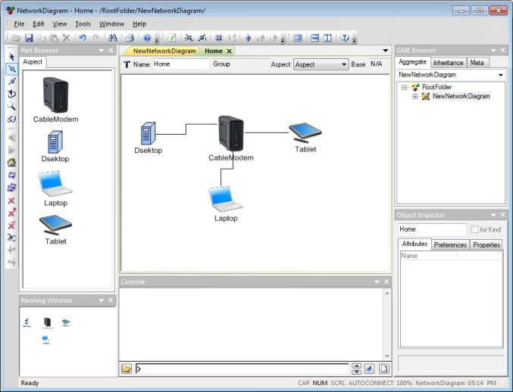
Development of Network Diagramming Tool with GME (cont.)
Model network structure

Slide 51
MLCBD

Slide 52
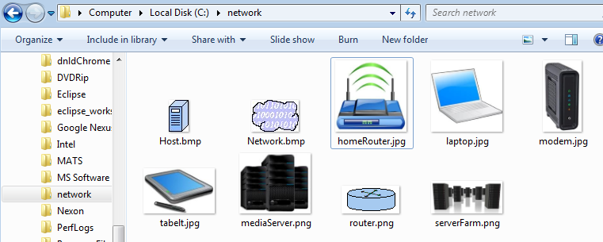
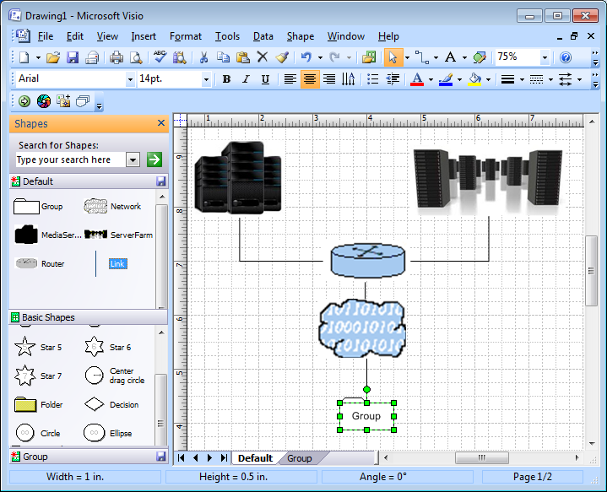
Development of Network Diagramming Tool with MLCBD
Creating a new Network Diagram

Slide 53
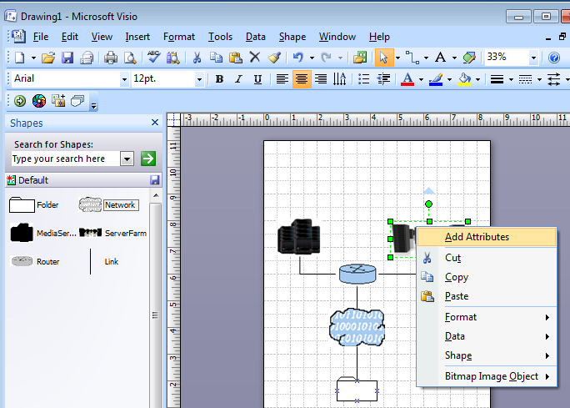
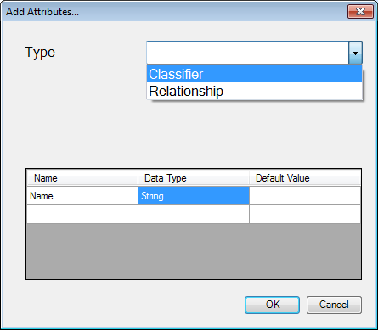
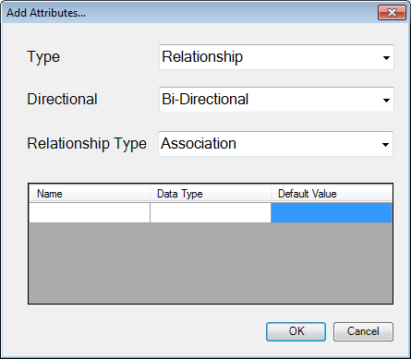
Development of Network Diagramming Tool with MLCBD (cont.)
Set Attribute

Slide 54
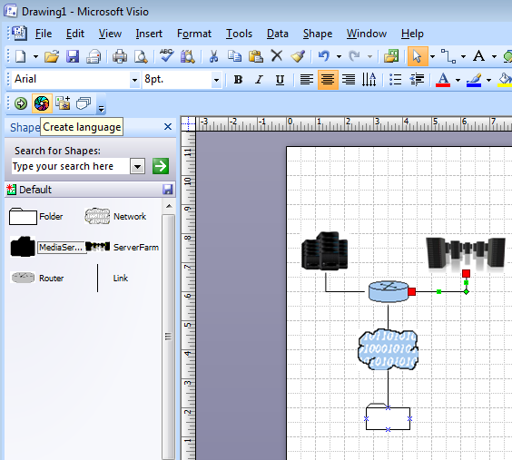
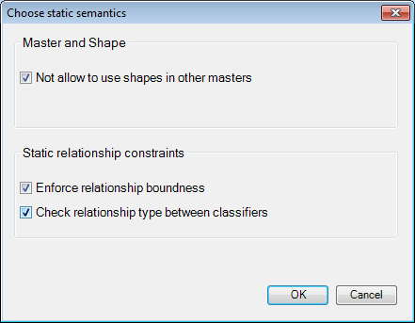
Development of Network Diagramming Tool with MLCBD (cont.)
Create a language

Slide 55
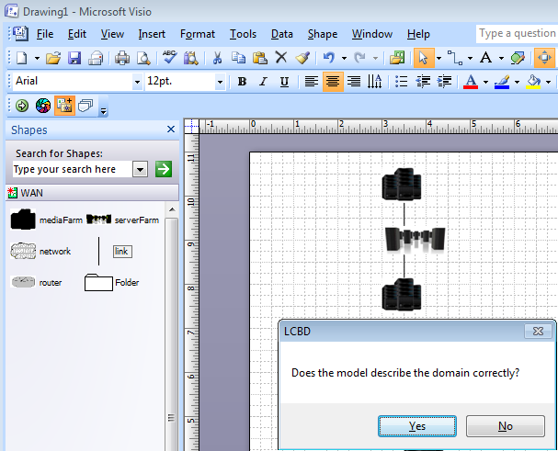
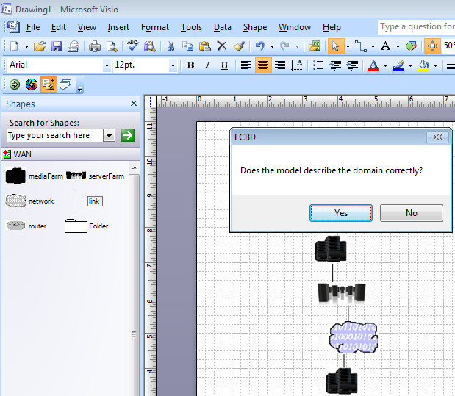
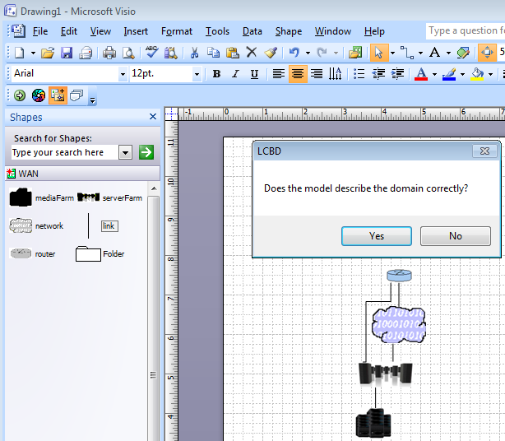
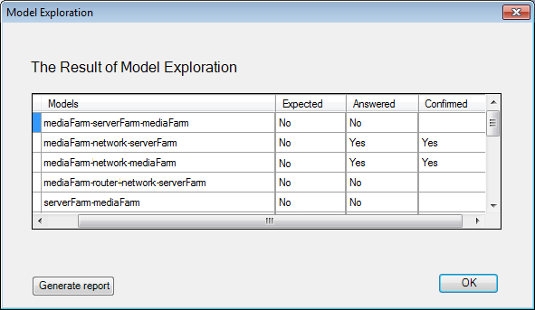
Development of Network Diagramming Tool with MLCBD (cont.)
Explore Model Space

Slide 56
Comparison
 |  | GMF | GME | MLCBD
Complexity |  | High | High | Low
Completeness of the graphical representation |  | High | High | High
Analysis and Debugging | Metamodel | Support | Support | N/A
 | Model | N/A | N/A | Model Space Exploration
Language Evolution |  | Medium | High | N/A
GMF: Graphical Modeling Framework
Notes:
Complexity is measured by the amount of knowledge and the number of operations to develop a DSML using the approach

Slide 57
Future work and conclusion

Slide 58
Future Work
Intermediate Design Space
  Support language evolution
  Mining more metamodel design patterns
  Capturing dynamic semantics
Model Space Exploration
  Elaborating model creation algorithm by applying model transformation and/or rule-based approach
  Developing layout management algorithm
Syntax Map
  Specifying the Syntax Map with a formal technique

Slide 59
Summary
A Syntax Map helps domain experts to describe requirements of a DSML unambiguously and may minimize miscommunication between stakeholders
Intermediate Design Space offers a flexible modeling environment to describe notions of a domain with a high-level of graphical completeness
Intermediate Design Space allows domain experts to create their own DSMLs without programming language development expertise by applying a metamodel inference technique using metamodel design patterns
Model Space Exploration helps domain experts to verify the correctness of inferred metamodel as well as find missing notions of the domain

Slide 60

Thank you for your attention
This work supported in part by NSF CAREER #1052616.

Slide 61
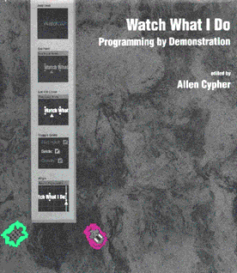


Related Work
User-Centric Approach
  Program-By- Example
  Query By Example
  By-Demonstration
Support Sketch-level notations
  Flexible Modeling Tools by Ossher et al.
  OMME by Volz and Jablanski
Language Creation
  Grammar Inference
    MARS by Javed et al.
    Inferring metamodel for runtime system data by Song et al.
Language Verification
  Design Space Exploration
    DESERT by Neema et al.
    DaRT by Bondé et al
Requirement Modeling
  Use Case Maps by Amyot et al.
  Syntax Graph by Taylor

Slide 62
Related Work: Flexible Modeling
Flexible Modeling Tools for Pre-Requirements Analysis
  Ossher et al., 2010
  Blended the flexibility of office tools with the formality of modeling tools for pre-requirement capturing
  Represent pre-requirements with free form shapes and annotate meanings of shapes by domain users
  Migrate pre-requirements model into downstream modeling tools and improve maintainability of pre-requirements
OMME - A Flexible Modeling Environment
  Volz and Jablonski, 2010
  Bridge the gap between free-from drawing tools and formal modeling tools
  Metamodel and semantics are predefined and maintained under model repository
  Draw diagram with free-form shapes and link free form shapes with predefined formal (meta)models and constraints
  ← May need to collaborate with language development experts

Slide 63
Related Work: Abstract/Concrete Syntax Inference
MARS: A Metamodel Recovery System using Grammar Inference
  Javed et al., 2008; Liu et al., 2010
  Recover metamodel from a set of domain models, which are the legacy of previous modeling tools and their syntax description and manual are lost
  Infer metamodel after transforming a set of domain model examples into context-free grammar using Model Representation Language (MRL)
Inferring Meta-Models for Runtime System Data from the Clients of Management APIs
  Song et al., 2010
  Infer metamodel that manages runtime system data (e.g., running objects, heap usage, garbage collection, and etc) from source codes developed to collect and manage runtime information using system management APIs
  The source codes are transformed into data-based program dependency graph

Slide 64
Related Work: Model Space Exploration
Constraint-Based Design-Space Exploration and Model Synthesis
  Neema et al., 2003
  Domain-independent tool chain for defining design spaces and executing constraint-based design space exploration
  Use Ordered Binary Decision Diagrams (OBDDs) for constraint satisfaction
Metamodels and MDA Transformations for Embedded Systems
  Bondé et al., 2005
  Applied MDA to design embedded hardware and software concurrently
  Define hardware/software metamodel platform independently and then generate platform-specific models by applying model transformation

Slide 65
Backup slides

Slide 66
Comparison : Complexity
GMF (Graphical Modeling Framework)
  Required knowledge about five models
  Changes in a model propagate to other models because five models are interrelated

Slide 67
Comparison : Complexity (cont.)
GME (Generic Modeling Environment)
  Need to handle four different aspects to develop a DSML
  Similar to GMF, models are interrelated, and incomplete modeling in an aspect results in build error

Slide 68
Comparison : Complexity (cont.)
Number of metamodel elements and operations
Example | GME | GMF | MLCBD
# of Metamodeling Elements | 22 | 14
# of models | 4 Aspects | 5 Models | 6 Domain Models
# of Operations | 68 | 153 | 41 (w/o MSE) 78 (w MSE)
Notes:
# of Metamodeling elements of MLCBD 10

Slide 69
DSML Development Challenge (cont.)
“most users lack the expertise to properly identify and compose the routines appropriate to their application”
  Mark E. Stickel, Richard J. Waldinger, Michael R. Lowry, Thomas Pressburger, and Ian Underwood, “Deductive Composition of Astronomical Software from Subroutine Libraries,” In Proceedings of International Conference on Automated Deduction, Nancy, France, July 1994, pages 341-355.
“a common scenario is that the programmer knows what type of object he needs, but does not know how to write the code to get the object”
  David Mandelin, Lin Xu, Rastislav Bodík, and Doug Kimelman, “Jungloid Mining: Helping to Navigate the API Jungle.,” ACM SIGPLAN Conference on Programming Language Design and Implementation, June 2005, Chicago, IL, pages 48-61
Result is ambiguous DSML requirements and
poorly designed/implemented DSML

