Slide 1
Refining High Performance FORTRAN Code from Programming Model Dependencies
Ferosh Jacob University of Alabama
Department of Computer Science
fjacob@crimson.ua.edu
http://cs.ua.edu/graduate/fjacob

Slide 2
Challenges in Parallel Programming
the execution plot of the satisfiability problem in Figure 1 shows that even though the performance of OpenMP and MPI are comparable, for small problems the OpenMP version is faster than an MPI solution. In cases where the size of the data varies, different versions of the same program might be required if a single HPC library is used.

Slide 3
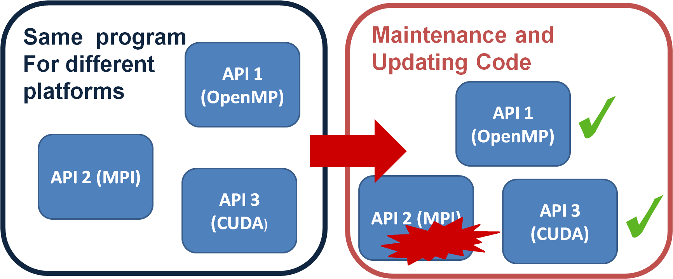
Architecture Dependencies in Parallel Programming
Manually maintaining such variations induces unnecessary redundant effort that is also very prone to human errors in maintaining and updating the core algorithms. Therefore, the development of an HPC program is often limited to a specific parallel library. Otherwise, the programmer pays the price of developing and maintaining several versions of the same program.

Slide 4
Program Analysis of FORTRAN OpenMP Programs
Analysis Conclusion
A DSL that uses only the parallel features can express parallel problems in a platform-independent manner. Most of the programs involve an initialization segment that initializes the execution of the parallel part, and a code segment that is used to collect data from the parallel instances

Slide 5
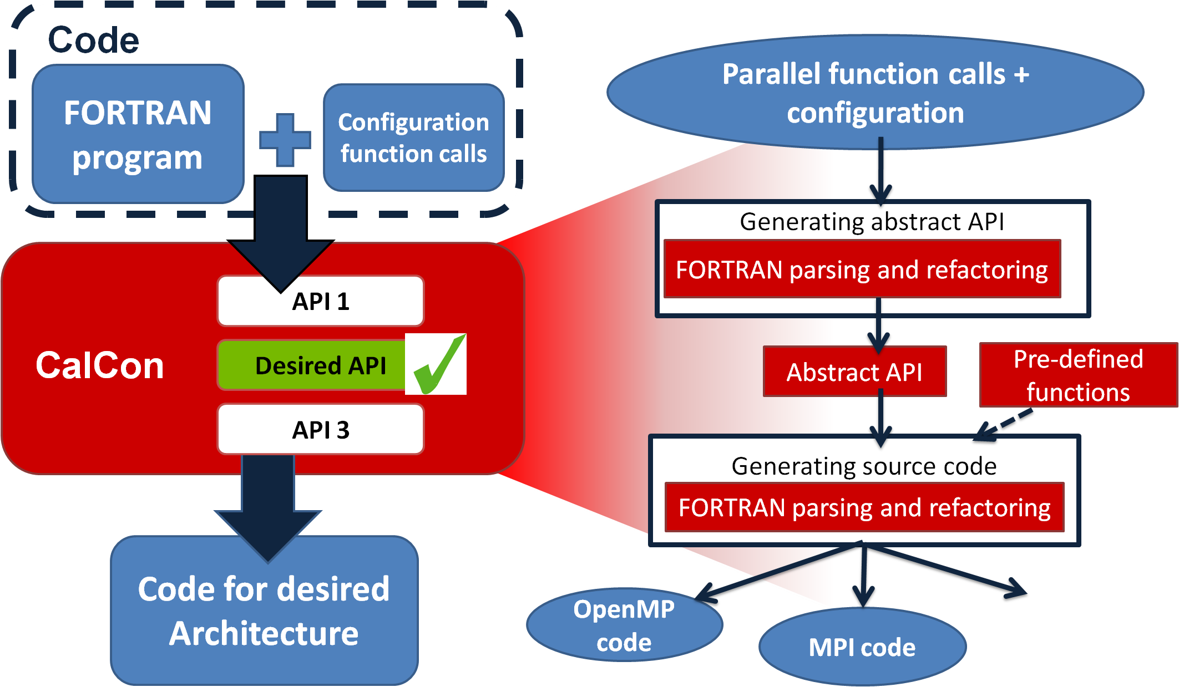
Proposed Approach to Express Parallel Programs in FORTRAN

Slide 6
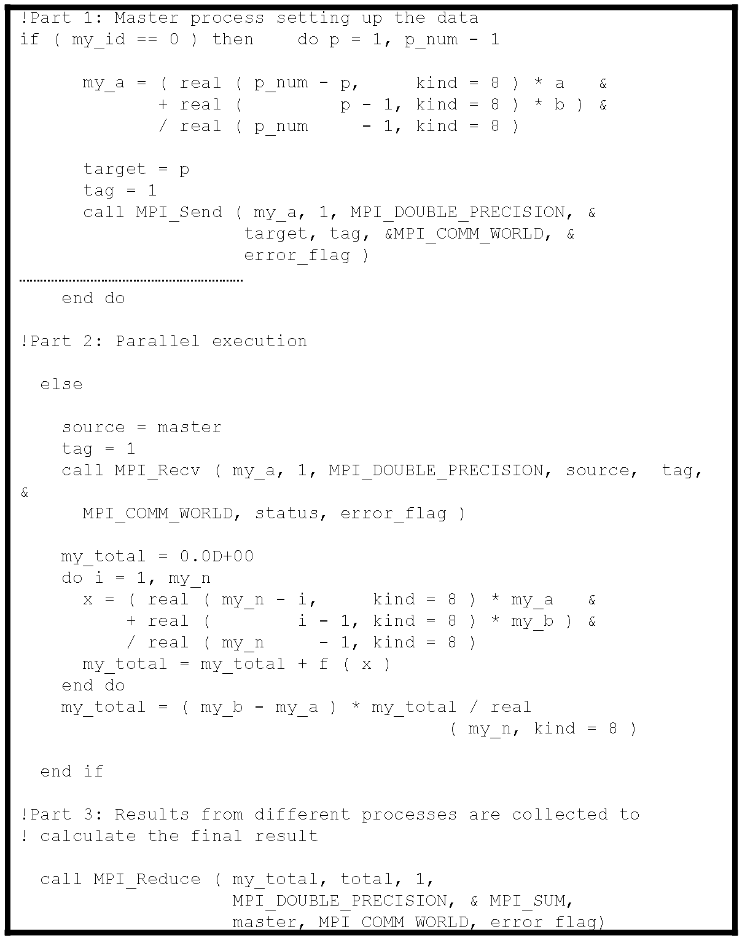
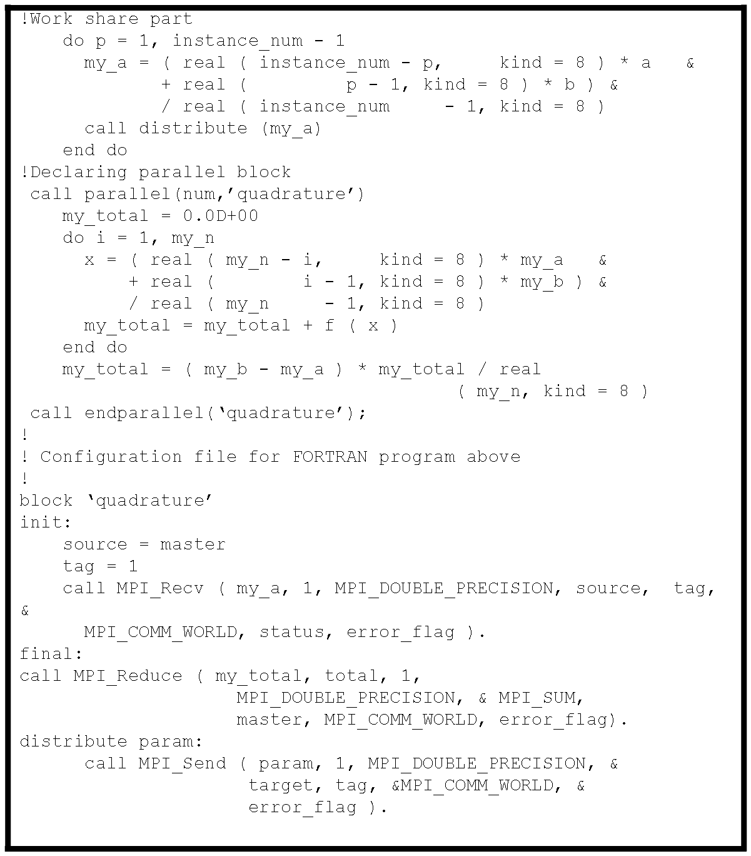
MPI Case Study

Slide 7
Conclusion and Future Work
For the evolution of high performance FORTRAN code, it is necessary to separate the code of the core computation from the machine or architecture dependencies that may come from usage of a specific API.
We analyzed ten FORTRAN programs from diverse domains to understand the usage of OpenMP in scientific code. The analysis revealed that programs often share a common structure such that platform and machine details could be specified in a different file.
A case study is included to show that the approach can be extended to other architectures.
Future work includes refactoring the legacy code to the approach specified in this paper with minimum input from the user. Another direction will be focused on executing the parallel programs to a GPU. Conducting a user study to explore the advantages and disadvantages from a human factors perspective is another direction of work.

Slide 8
Thank You
Questions?
Ferosh Jacob University of Alabama
Department of Computer Science
fjacob@crimson.ua.edu
http://cs.ua.edu/graduate/fjacob

