Slide 1
CUDACL: A Tool for CUDA and OpenCL Programmers
Ferosh Jacob¹, David Whittaker², Sagar Thapaliya²,
Purushotham Bangalore², Marjan Memik³² , and Jeff Gray¹
¹Department of Computer Science, University of Alabama
² Department of Computer and Information Sciences, University of Alabama at Birmingham
³ Faculty of Electrical Engineering and Computer Science, University of Maribor
Contact: fjacob@crimson.ua.edu

Slide 2
Challenges to GPU programmers
Accidental complexity
- Improper level of abstraction
Is it possible to allow programmers to use GPU’s as just another tool in the IDE?
A programmer often selects a block of code and specifies the device on which it is to execute in order to understand the performance concerns. Should performance tuning be at a high-level of abstraction, such as that similar to what a Graphical User Interface (GUI) developer sees in a What You See Is What You Get (WYSIWYG) editor?

Slide 3
Challenges to GPU programmers
Accidental complexity
- Configuration details
A simple analysis for CUDA or OpenCL reveals that there are few configuration parameters, but many technical details involved in the execution. How far can default values be provided without much performance loss?
How much information should be shown to the user for performance tuning and how much information should be hidden to make programming tasks more simplified?

Slide 4
GPU program analysis
Goal: To explore the abstraction possibilities observed from their
common capabilities.
Data flow analysis using CUDA
GPU programs
Templates in OpenCL programs
Goal: To study the flow of data
from GPU to CPU or vice versa,
the flow of data between multiple
threads, and the flow of data
within the GPU (e.g., shared to global or constant).
Goal: To extract the possible templates from an OpenCL program.

Slide 5
CUDA analysis
For the analysis, 42 kernels were selected from 25 randomly
selected programs that are provided as code samples from the
installation package of NVIDIA CUDA.
Level A
Level B
Level C

Slide 6
OpenCL analysis
Motivation: In a program oclMatrVecMul from the OpenCL installation package of NVIDIA, three steps – 1) creating the OpenCL context, 2) creating a command queue for device 0, and 3) setting up the program – are achieved with 34 lines of code.
If the steps for a general OpenCL program can be found, templates can be provided that can free the programmer from writing much of the common code manually. Furthermore, one or more steps can be abstracted to standard functions to simplify the development process.
Data: 15 programs were randomly selected from the code samples that are shipped with the NVIDIA OpenCL installation package.

Slide 7
Analysis conclusions
CUDA
Automatic Code Conversion: There are a fair amount of programs (48%), whose code can be automatically generated if the sequential code is available.
Copy mismatch: There exists programs (12%) where all the variables in the kernel are not copied. Even though the variables are not copied, memory should be allocated in the host code before the first access.
OpenCL
Default template: Every OpenCL program consists of creating a context, setting up the program, and cleaning up the OpenCL resources.
Device specification: Each kernel could be specified with a device or multiple devices in which the kernel is meant to be executed.

Slide 8
Design of CUDACL
Configuration parameters
C or Java code
CDT/JDT Parsing
C or Java code with Abstract APIs
Pre defined functions
CDT/JDT Parsing
C with OpenCL
C with CUDA
Java with OpenCL
Java with CUDA

Slide 9
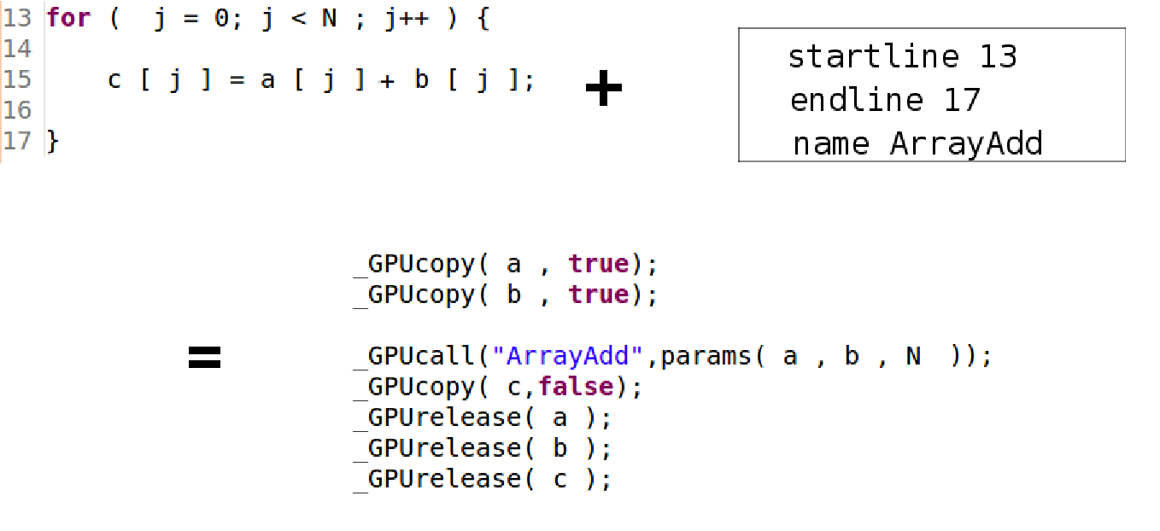
CUDACL in action
Host code of Arrayadd

Slide 10
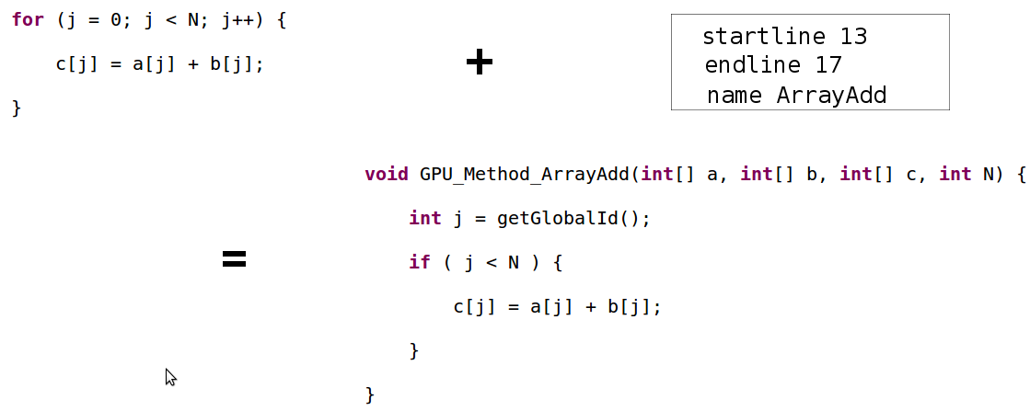
CUDACL in action
Kernel code of Arrayadd

Slide 11
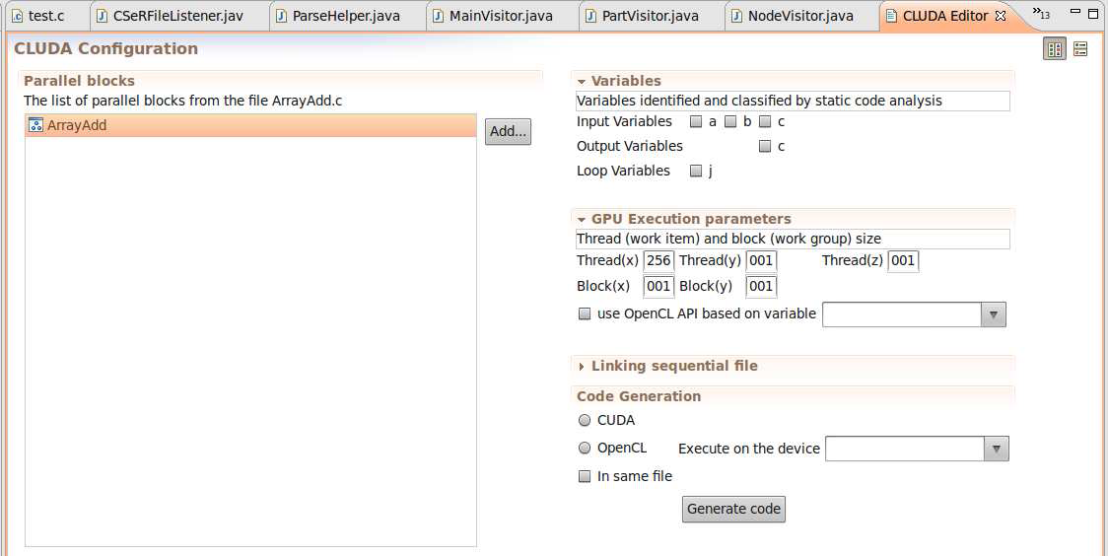
CUDACL in action
Eclipse plug-in editor for configuration

Slide 12
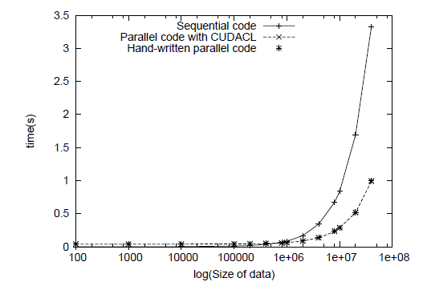
Case study 1
Creation of Octree with CUDA
Octree is a popular tree data structure that is often used to represent volumetric data. Volumetric 3D data is widely used in computer graphics
Program written in C language
Level A program

Slide 13
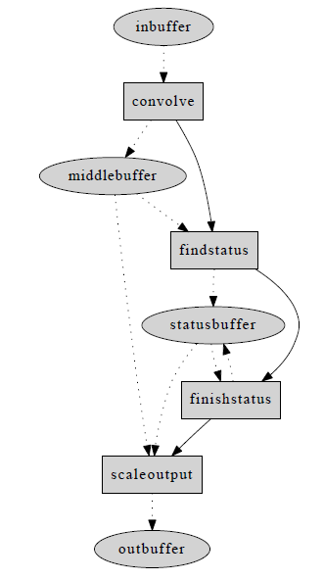
Case study 2
Edge detection with OpenCL
Farmland is found by using a pattern matching algorithm to search for large, flat, contiguous squares and circles on the edge map of the land, which is
created by running a Sobel edge detector.
Program written in Java language
Level C program

Slide 14
Related works
Sequential code to Parallel
PFC¹
PAT²
CUDA
hiCUDA³
CUDA-lite⁴
OpenCL
CUDACL
R. Allen and K. Kennedy,“PFC: a program to convert fortran to parallel form,” In Supercomputers: Design and Applications, pp. 186–203, 1984
B. Appelbe, K. Smith, and C. McDowell, “Start/Pat: a parallelprogramming toolkit,” IEEE Softw., pp. 29–38, 1989.
T. D. Han and T. S. Abdelrahman, “hiCUDA: A high-level directivebased language for GPU programming,” in Proceedings of 2nd Workshop on General Purpose Processing on Graphics Processing Units, Washington, D.C., March 2009, pp. 52–61..
S.-Z. Ueng, M. Lathara, S. S. Baghsorkhi, and W.-M. W. Hwu, “CUDAlite: Reducing GPU programming complexity,” in Proceedings of the International Workshop on Languages and Compilers for Parallel Computing,Edmonton, Canada, July 2008, pp. 1–15.

Slide 15
Conclusion and Future work
Conclusion
A graphical interface is available with default values to configure a GPU parallel block in ‘C’ and Java programs to generate CUDA and OpenCL programs.
Two case studies were presented to show that CUDACL, and its associated tool support within Eclipse, can be useful for a wide range of applications.
Future work
As an extension of the work, a Domain-Specific Language (DSL) is being designed to represent the interface for the configuration.
More examples should be tried to evaluate the tool.

Slide 16
Thank You
Questions?
Ferosh Jacob¹, David Whittaker², Sagar Thapaliya²,
Purushotham Bangalore², Marjan Memik³² , and Jeff Gray¹
¹Department of Computer Science, University of Alabama
² Department of Computer and Information Sciences, University of Alabama at Birmingham
³ Faculty of Electrical Engineering and Computer Science, University of Maribor
Contact: fjacob@crimson.ua.edu
http://cs.ua.edu/graduate/fjacob/

