Slide 1
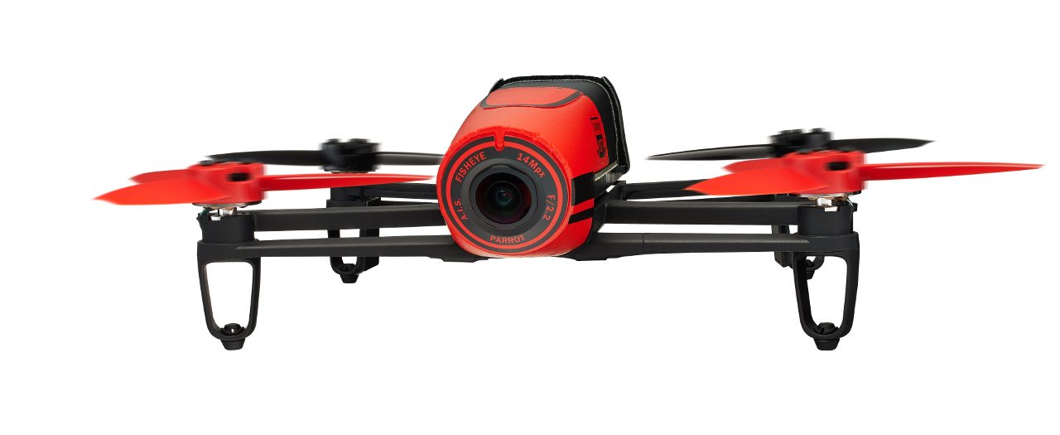
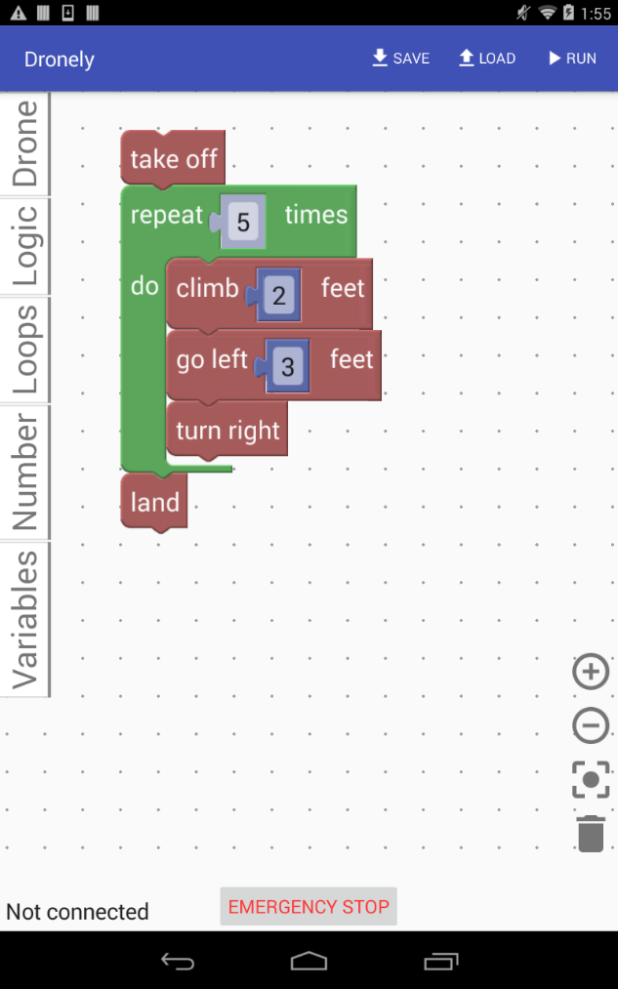
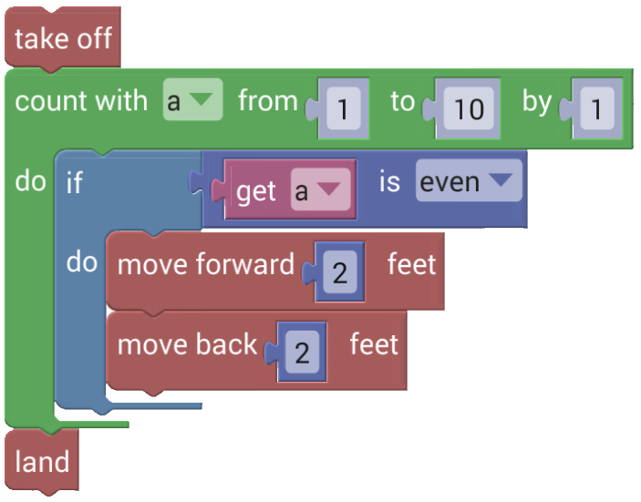
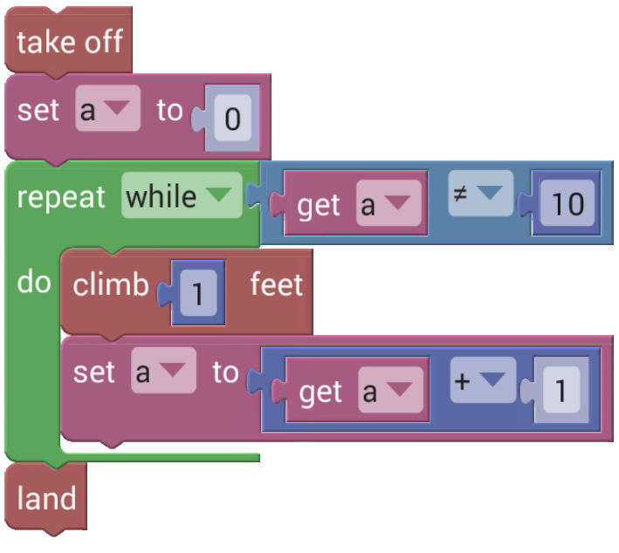
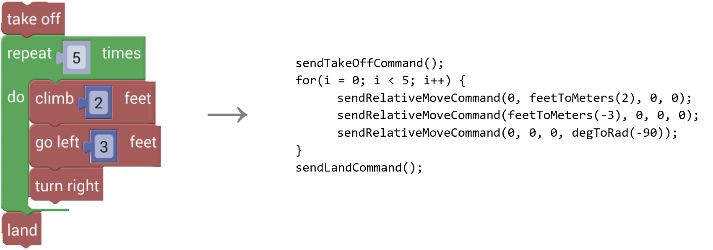
Dronely: A Visual Block
Programming Language for the Control of Drones
Eric Tilley
Department of Computer Science, University of Alabama
Abstract
Language and Implementation
Safety Features
Dronely is a visual block programming language that allows users to build programs for the control of small drones. Dronely uses drones as a way of raising interest in computer science among K-12 students by presenting a user-friendly and intuitive drag-and-drop interface for building programs that have a physically observable effect. Although the language was designed so that simple tasks are straightforward to accomplish, more complex programs can still be implemented in Dronely.
Dronely is implemented as an integrated development environment (IDE) for Android tablets. It presents the user with an intuitive interface for building visual block programs (see figure to left). The interface is powered by Google Blockly, a popular framework for building blocks-based programming languages [3]. On the left side of the screen, a list of block categories is displayed. When the user taps on a category, he or she is allowed to select a block from that category, which they can then “drag and drop” onto the current program canvas. Blocks fit together like puzzle pieces, so it is very clear to the user which blocks are compatible with one another— unlike traditional text-based languages, where the user has to worry about parameter and return types.
Safety is one of Dronely’s key design elements. Because Dronely is designed to be used by beginner programmers, it will naturally be used by younger users, so safety is a particularly important concern.
Dronely sets conservative maximum velocity and acceleration limits and prohibits operations above a safe altitude. It also provides an “Emergency Stop” button which is available at all times.
Dronely’s drone communication module maintains an internal state machine with frequent sanity checks, which helps to ensure that the drone will never deviate from its commanded path while it is under the control of Dronely.
Background & Related Work
Visual block languages have become very popular, especially in the field of computer science education. They allow beginning programmers to “get their feet wet” in programming without facing the steep learning curve of traditional text-based programming languages.
There are many existing applications that implement block languages for the control of robots and drones. One popular application, Tickle, provides its users with a blocks-based interface for building programs targeting smart home devices, connected toys, and robots, but not flying drones [1]. Another application, Tynker, allows its users to use a block-based interface to build programs to solve puzzles, build games, and control robots and drones [2]. Both Tickle and Tynker are commercial, closed-source applications that require payment to unlock certain functionality.
Dronely is designed to be different than existing applications like Tickle and Tynker. Dronely focuses solely on Parrot drones, avoiding the clutter of additional functionality and presenting the user with a clean interface designed for a single purpose. Dronely is also completely free of charge, removing potential barriers for its use in education. Most importantly, Dronely is open source, allowing its users to modify it as needed to fit their purposes.
Dronely provides a variety of blocks for controlling the drone (e.g., “take off”, “land”, “climb x feet”, “do a barrel roll”, etc.) Dronely also provides blocks for control flow, Boolean logic and mathematics functions. It supports user-defined global variables, which are implicitly typed. In order to maintain simplicity, user-defined subroutines are not allowed. Because it is primarily an educational language, Dronely is designed to make simple tasks straightforward and easy to accomplish, but to still make complex tasks possible (e.g., Papert’s “low floor/high ceiling”) [4]. Two sample programs are shown at the top right.
Since Dronely is powered by Blockly, its code generation engine must emit JavaScript code (an example of code generation is shown to the right in the middle). When the user runs a program, JavaScript code is generated and run in a hidden WebView. This WebView is connected back to Dronely through a JavaScript bridge, with which Dronely relays the user’s commands to the drone. A block diagram of Dronely usage is shown at the bottom right.
Conclusion
Dronely balances simplicity and power and allows the user to accomplish many programming tasks with a Parrot drone, both ranging from simple take-offs and landings to complex choreographed aerobatic stunts. Dronely is designed from the ground up to integrate its safety features with the pre-existing Parrot drone safety features in order to ensure operations are as safe as possible at all times.
References
[1] Tickle—https://tickleapp.com/
[2] Tynker for Tablets— https://www.tynker.com/mobile/
[3] Blockly Overview – https://developers.google.com/blockly/guides /overview
[4] Papert, S. Mindstorms: Children, Computers, and Powerful Ideas. New York, NY: Basic Books, 1980.

