Slide 1
Using the Structural Location of Terms to Improve the Results of Text Retrieval based Approaches to Feature Location
Brian Eddy
Department of Computer Science
The University of Alabama

Slide 2
Committee
Dr. Jeff Gray (Committee Chair)
Dr. Nicholas A. Kraft (Previous Chair)
Dr. Susan Vrbsky
Dr. Randy Smith
Dr. Jeffrey Carver

Slide 3
Outline
Introduction
Preliminary Study
Structural Weighting of LDA
Structured Retrieval
Conclusion and Future Work
Notes:
Especially, when the size of the system starts to look like this. Keeping in mind that the system pictured here is still small.

Slide 4
Staged Software Life Model
Initial Development
Evolution
Evolution Changes
Servicing
Servicing Patches
Phaseout
Closedown
Software Change
Rajlich, V. Bennett, K.H. (2000). “A staged model for the software life cycle”. IEEE Computer, 33, 66-71

Slide 5
Life Model in Perspective
Majority of time is in reading the code!
Alkhatib, G., “The maintenance problem of application software: an empirical analysis,” Journal of Software Maintenance: Research and Practice, 1992.
Erlikh, L., “Leveraging legacy system dollars for e-business,” IEEE IT Pro, pp. 17–23, May/June 2000.
Müller, H., Jahnke, J., Smith, D., Storey, M.-A., Tilley, S. , and Wong, K., “Reverse engineering: A roadmap,” in Proc. of the Future of Software Engineering, Jun. 2000.

Slide 6
New Developer Dilemma
Use an as-needed strategy instead!

Slide 7
TR-Based Feature Location
Source Code Files
Text Extraction
Preprocessing
Model
Most concerned with the rank of the first relevant method
Ranked List of Results
Classifier
Change Request
Preprocessing

Slide 8
Structuring Source Code
Method
Signature
Method Name
Parameters
Body
Variable
Type
Name
Area Triangle
Type
double
side1
Comments
Leading
Line
Computes the area
Compute the
lengths
Point
Name
point1
Method Call
Compute Distance
More Flexibility
Increased Accuracy
Notes:
We can expand upon this idea by breaking a method down into several subcomponents. This allows for two things to happen.
First, queries are more flexible and will allow for a wider arrange of query types. For instance, if you want a query that searches for one set of terms in one component and another set in another component.
Second, the possibility of increased accuracy due to the ability to weight components differently.

Slide 9
Outline
Introduction
Preliminary Study
Structural Weighting of LDA
Structured Retrieval
Conclusion and Future Work
Notes:
Especially, when the size of the system starts to look like this. Keeping in mind that the system pictured here is still small.

Slide 10
Latent Dirichlet Allocation
K Topics
M Documents
Document Distribution
0.1
0.23
0.27
0.17
0.27
0.13
0.33
0.17
0.06
0.13
0.2
0.2
0.17
0.04
0.13
0.2
0.1
0.1
Compute:
P(topic t | document d)
P(word w | topic t)
Reassign words based on P(t | d) * P(w | t)
Repeat N times
Colors – topic + word associations

Slide 11
Problems with LDA and Source Code
Proper Configuration
Source of extracted text (identifiers, comments, literals)
Effects of different queries (titles, descriptions, combined)
Model and sampling parameters
Sparse Models (relative to natural language)
Each document has fewer dominant topics
Most important terms may be used the least in the document

Slide 12
Configuring the Model
K, number of topics in Θ
w + z, word and topic pair
N, the number of topic word pairs
Θ, the document topic distribution
M, the number of documents in the corpus
α, affects the number of topics per document
β, affects the number of words per topic
L.R. Biggers, C. Bocovich, R. Capshaw, B.P. Eddy, L.H. Etzkorn, and N.A. Kraft, “Configuring latent Dirichlet allocation based feature location,”
Empirical Software Engineering, 19(3): 465-500, 2014, doi:10.1007/s10664-012-9224-x.

Slide 13
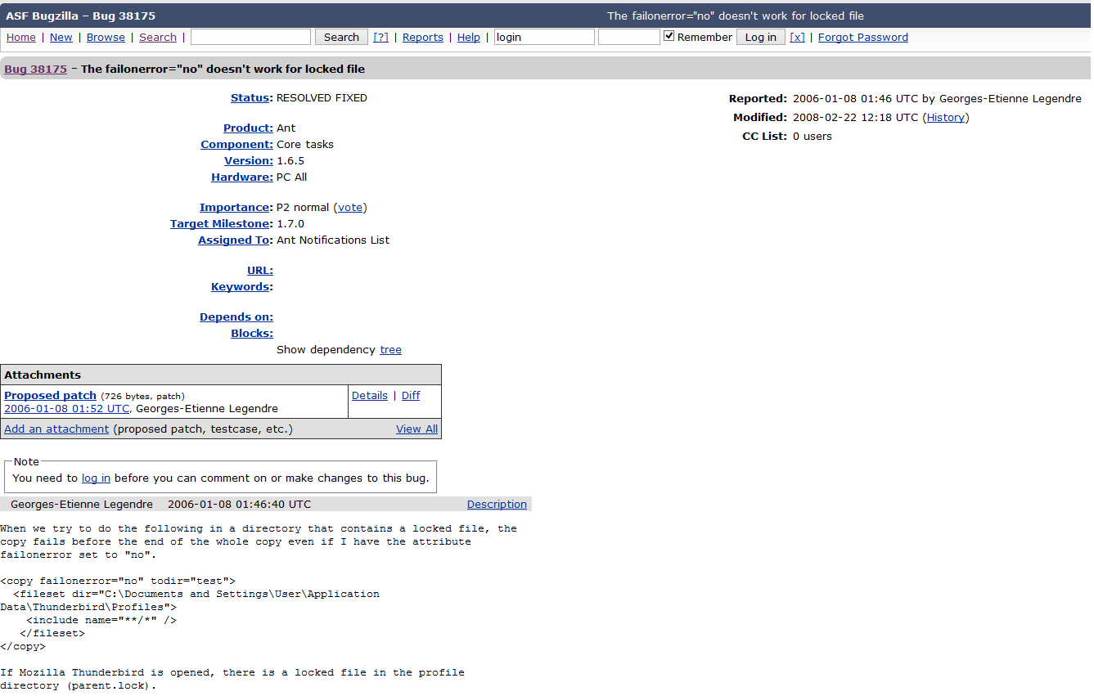
Configuring the Query
Recreation
Environment
Title and ID
Current Status (e.g., New, Won’t Fix, Resolved)
Priority
Description of Bug or Feature

Slide 14
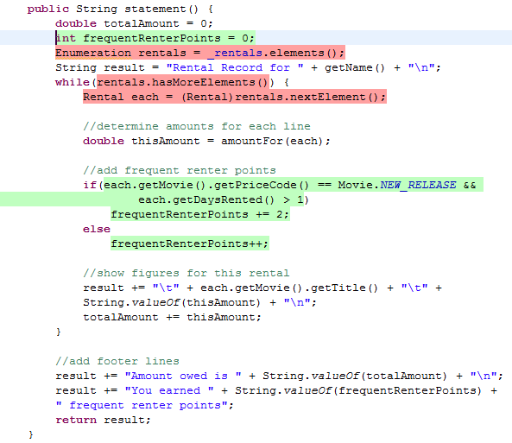
Configuring the Text Extractor and K
Source Code lexicons:
comments
identifiers
literals
Need to choose the right number of topics (K) to represent the lexicons

Slide 15
Case Study
LDA Feature Location Process
Query
Text Extractor and K
α & β
6 Open Source Systems;
618 Features
Compared Results to Goldsets
Open Source Systems varied by size and domain
Varied one of Query, α and β, or Text Extractor and K, while controlling other two
Compared results of the concept location to a known set of relevant methods

Slide 16
Recommendations
Size | KLOC | Unique Terms | Term Usages | Text | Queries | K | α | β
Small | <100 | <10,000 | <200,000 | ICL | Combined | 300 | 1.0 | 0.5
Small-Medium | <200 | ~10,000 | <500,000 | ICL | Combined | 400 | 1.0 | 0.25
Medium-Large | >200 | >10,000 | >500,000 | ICL | Combined | 500 | 1.0 | 0.1
Large | >1,000 | >10,000 | >500,000 | ICL | Combined | 500 | 1.0 | 0.1
Always use combined for queries
Always extract identifiers, comments, and literals
Vary model parameters based on the size of the system

Slide 17
Outline
Introduction
Preliminary Study
Structural Weighting of LDA
Structured Retrieval
Conclusion and Future Work
Notes:
Especially, when the size of the system starts to look like this. Keeping in mind that the system pictured here is still small.

Slide 18
Problems with LDA and Source Code
Proper Configuration
Source of extracted text (identifiers, comments, literals)
Effects of different queries (titles, descriptions, combined)
Model and sampling parameters
Sparse Models (relative to natural language)
Each document has fewer dominant topics
Most important terms may be used the least in the document

Slide 19
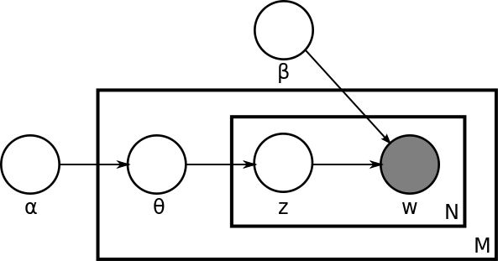
Improving the Topic Distribution
Low Number of Dominant Topics
Most relevant topics represented by a few terms
Apply a scalar multiple to counts of important terms
Improves θ, the document topic distribution
Colors – topic + word associations
Preliminary Study: Bassett, B., Kraft, NA “Structural information based term weighting in text retrieval for feature location”,
IEEE 21st International Conference on Program Comprehension (ICPC), 2013

Slide 20
Selecting Terms to Weight
Selected subset of terms to weigh (due to feasibility constraints)
Choices based on previous source code summarization study
Developers indicated two important term types:
Leading terms (comments and signature)
Unique terms (terms not used commonly by other methods)
Choices: leading and body comments, method names, parameters, and local variables
B.P. Eddy, J.A. Robinson, N.A. Kraft, and J.C. Carver, “Evaluating Source Code Summarization Techniques: Replication and Expansion,” Proceedings of the 21st IEEE International Conference on Program Comprehension (ICPC’13), San Francisco, CA, USA, pp. 13-22, May 2013

Slide 21
Case Study
LDA Feature Location Process
Leading Comments
Parameters
Local Variables
Body Comments
Method Names
4 Open Source Systems;
372 Features
Compared Results to Goldsets
Open Source Systems varied by size and domain
Ran every possible weighting configuration using 4 scaling factors (1,2,4,8)
Compared raising weights on each lexicon individually and the top configurations for each system
Compared weights to the term contributions and densities for each lexicon

Slide 22
Evaluation
Effectiveness measure – rank of the first relevant measure
Mean Reciprocal Rank (MRR) – reciprocal of effectiveness measure averaged over all queries in system
$$\frac{1}{|Q|}\sum_{i=1}^{|Q|}{\frac{1}{r_{i}}}$$

Slide 23
Changes in Performance by Component (ArgoUML)

Slide 24
Changes in Performance by Component (JabRef)

Slide 25
Changes in Performance by Component (jEdit)

Slide 26
Changes in Performance by Component (muCommander)

Slide 27
Top Configurations (All Systems)
Top configurations are similar, but significantly better than unweighted

Slide 28
Factorial Analysis (All Systems)
Variable | Df | F value | Pr
LC | 3 | 382.79 | < 2.2e-16
MN | 3 | 219.37 | < 2.2e-16
P | 3 | 8.86 | < 0.01
LV | 3 | 34.09 | < 2.2e-16
LC:MN | 9 | 10.32 | < 0.01

Slide 29
Evaluating Lexicons (ArgoUML)

Slide 30
Evaluating Lexicons (JabRef)

Slide 31
Evaluating Lexicons (jEdit)

Slide 32
Evaluating Lexicons (muCommander)

Slide 33
Recommendations
Measure | Minimum Value
Document percentage | 30%
System lexicon density | 0.05
System unique term contribution | 0.08
System unique term density | 0.10
Method lexicon density | 0.10
Method unique term contribution | 0.25
If possible, compare unweighted configuration to a higher weighting factor for lexicon
If weighting, use higher weighting factors
Leave remaining lexicons as unweighted

Slide 34
Problems with LDA and Source Code
Proper Configuration
Source of extracted text (identifiers, comments, literals)
Effects of different queries (titles, descriptions, combined)
Model and sampling parameters
Sparse Models (relative to natural language)
Each document has fewer dominant topics
Most important terms may be used the least in the document
Findings are system-specific - How can we obtain the best results for new systems?

Slide 35
Applying Genetic Algorithms
Most Likely Candidates

Slide 36
Incorporating Randomization
Genetic algorithms can get stuck on local optima
Replace half configurations (non-elite) with random configurations from unsearched space

Slide 37
Results on Eclipse (MRR)
50 iterations of the genetic algorithm

Slide 38
Results on Eclipse (Silhouette)
50 iterations of the genetic algorithm

Slide 39
Outline
Introduction
Preliminary Study
Structural Weighting of LDA
Structured Retrieval
Conclusion and Future Work
Notes:
Especially, when the size of the system starts to look like this. Keeping in mind that the system pictured here is still small.

Slide 40
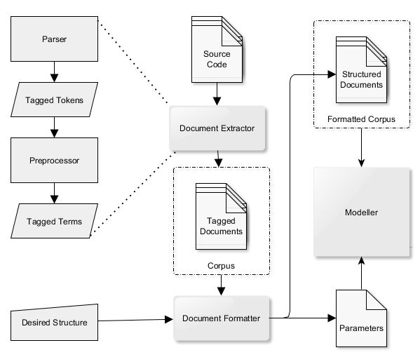
Creating a Text Model
Notes:
The challenges to the research proposed here is in three parts. The first is in determining the effects different structural components have on one another. For this we turn to statistics and factoral analysis. Second, finding the balance between flexibility and complexity in the structured document retrieval approach presented here. Finally, systems like the one outlined in this diagram will need to be developed to allow for using Indri to perform retrieval on source code. Such tools are already under development now.

Slide 41
Structured Queries
Standard LM Query, No Structure
(side1 computes Point)
Searches for Terms Appearing Within 4 Terms of One Another
#4(side1 point1 point2)
Searches for Terms Appearing in Specific Structural Components
[signature](Point point1 area)
[method_name](area)
[signature]([method_name](area)[parameter_name](point1))
Notes:
Looking at the types of queries provided by this approach, we see ways that a developer with some assumptions or knowledge of the system can obtain more precise results.
The top query is an example of a base query in the system that looks for the terms within the parentheses as appearing anywhere within the document. However, the second query assumes a particular order for these terms and also a certain window for which the terms appear.
The final set of queries narrow the search down by looking for methods where the terms appear in certain parts of the document.
This is increased flexibility.

Slide 42
Weighting Structured Queries
Weighs the Results of Each Sub-query For Overall Similarity
( 2.0 [signature](area) 1.0 [body](area))
An example of a Possible Weighting Function
0.67 log(likelihood([signature](area))) +
0.33 log(likelihood([body](area))).
Notes:
However, while the other queries are useful. Even more interesting is the possibility of combining structural weighting with the structured document retrieval approach. With a well trained weighting scheme, a query system might recommend such a query to a new developer with no knowledge of the underlying system. Such a query is given above with the a possible weighting function for determining the final similarity score for a query.
This approach should be compared to the traditional LDA model with structural weighting.

Slide 43
Example Corpora
Traditional Categories of Source Terms - ICL
Identifiers
Comments
Literals
Major Components of Methods - CSB
Comments
Signature
Body
Subcomponents of Methods (limited for feasibility) - LMPBV
Leading Comments
Method Names
Parameters
Body Comments
Local Variables
Other

Slide 44
Case Study
Structured
Feature Location Process
Query
Structural
Weighting
All Combinations
Combination
Of Fields
4 Open Source Systems;
372 Features
Compared Results to Goldsets
Question | Query Types | Values | Configurations
Query | Title, Combined, Description | Full corpus, Unweighted | 9
Field Combination | Title, Combined | All subsets of each corpus, Unweighted | 45
Weighting | Title, Combined | Full corpus, Scaling factors (1,2,4,8) | 1,152
All Combinations | Title | All subsets, All scaling factors | 4,608

Slide 45
Query Types (Individual Systems)
Title was best query type for each corpus and system

Slide 46
Query Types (All Systems)
Each Corpus and Query Type contributes to best results

Slide 47
Combinations of Fields (All Systems)
None of the full corpuses contributed to best results

Slide 48
Structural Weighting (All Systems)
97% of the best queries use a weighting configuration

Slide 49
All Combinations (All Systems)
LMPBV has highest percentages

Slide 50
Findings
Method
Comments
Leading
Body
Identifiers
Signature
Literals
Body
Method Names
Parameters
…
Local Variables
…
Concise queries preferred over longer queries
Queries should target components
Weighted configurations are often preferred over unweighted

Slide 51
Outline
Introduction
Preliminary Study
Structural Weighting of LDA
Structured Retrieval
Conclusion and Future Work
Notes:
Especially, when the size of the system starts to look like this. Keeping in mind that the system pictured here is still small.

Slide 52
Main Approaches
Structural weighting of LDA
Content and structure (CAS) queries in structured source code retrieval

Slide 53
Future Work
Improving learning algorithm for weights
User study of structured retrieval
Recommending structured queries
Improved interface for structured retrieval
Applying to additional software tasks (e.g., general search, impact analysis, traceability)

Slide 54
Conclusion
A large empirical study on the effects of structural weighting on LDA-based feature location
Recommendations and insights on how to choose a proper weighting configuration with little additional training
A learning algorithm for determining the optimum structural weighting over time
The introduction of content and structure (CAS)-based queries to search a corpus and provide additional flexibility to developers
A large empirical study on the effects of CAS queries to a FLT
Insights on how to structure a corpus for structured retrieval and for writing queries to return the best results

Slide 55
Journals (Feature Location\Text Retrieval)
B.P. Eddy, N.A. Kraft, and J. Gray “Understanding Structured Source Code Retrieval for Feature Location” (Submitting Mid-July)
B.P. Eddy, N.A. Kraft, and J. Gray “Structural Weighting of Latent Dirichlet Allocation for Feature Location” (Submitting August\September)
L.R. Biggers, C. Bocovich, R. Capshaw, B.P. Eddy, L.H. Etzkorn, and N.A. Kraft, “Configuring latent Dirichlet allocation based feature location,” Empirical Software Engineering, 19(3): 465-500, 2014, doi:10.1007/s10664-012-9224-x.

Slide 56
Conferences (Feature Location\Text Retrieval)
B.P. Eddy and N.A. Kraft, “Using Structured Queries for Source Code Search,” Proceedings of the 30th International Conference on Software Maintenance and Evolution (ICSME’14), Victoria, British Columbia, Canada, pp. 431-435, September 2014.
B.P. Eddy, “Structured Source Retrieval for Improving Software Search during Program Comprehension Tasks,” Proceedings of the ACM SIGPLAN conference on Systems, Programming, Languages and Applications: Software for Humanity 2014 (SPLASH’14), Portland, OR, USA, pp. 13-15, October 2014.
B.P. Eddy, “Incorporating Structured Queries into Software Search,” ACM SIGPLAN conference on Systems, Programming, Languages and Applications: Software for Humanity 2014 (SPLASH’14) Student Research Competition, Portland, OR, USA, October 2014.
B.P. Eddy, J.A. Robinson, N.A. Kraft, and J.C. Carver, “Evaluating Source Code Summarization Techniques: Replication and Expansion,” Proceedings of the 21st IEEE International Conference on Program Comprehension (ICPC’13), San Francisco, CA, USA, pp. 13-22, May 2013.
B.P. Eddy, Jeffrey A. Robinson, “Supporting feature location and mining of software repositories on the Amazon EC2,” Proceedings of the 51st ACM Southeast Regional Conference (ACM-SE’13), Savannah, GA, USA, pp. 9:1-9:6, March 2013.
L.R. Biggers, B.P. Eddy, N.A. Kraft, and L.H. Etzkorn, “Toward a Metrics Suite for Source Code Lexicons,” Proceedings of the 27th IEEE International Conference on Software Maintenance (ICSM’11), Williamsburg, VA, USA, pp. 492-495, September 2011.

Slide 57
Other Projects
How developers debug (general languages and model transformations)
General (planned first author journal)
Model Transformations (second author conference\journal)
Designing a MOOC for teaching CS Principles to high school teachers
Planned SIGCSE conference paper and journal
Debugging Model Transformations
J. Corley, B.P. Eddy, E. Syriani, and J. Gray “Omniscient Debugging for Model Transformations” (in submission)
J. Corley, B.P. Eddy, J. Gray “Towards Efficient and Scalable Omniscient Debugging for Model Transformations,” 14th Domain-Specific Modeling (DSM), Portland, OR, USA, 6 pages, October 2014.
Efficient Algorithms on GPU
J. Robinson, B.P.Eddy, Brandon Dixon “Analysis of a High Performance TSP Solver on the GPU” (in preparation)

