Slide 1
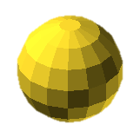
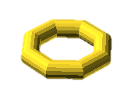
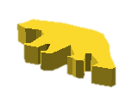
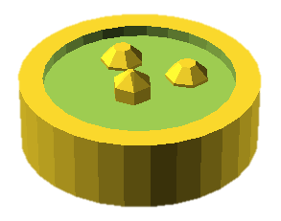
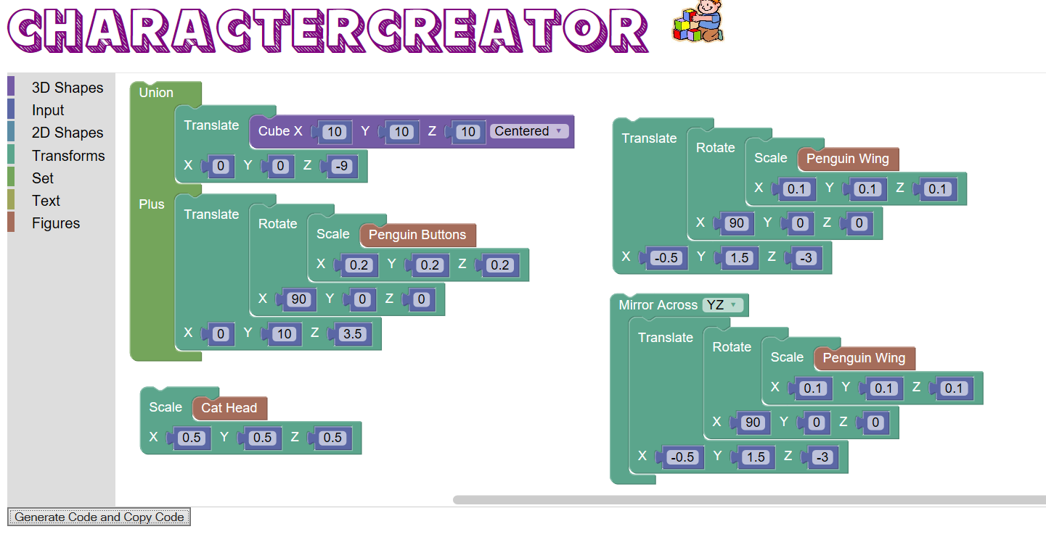
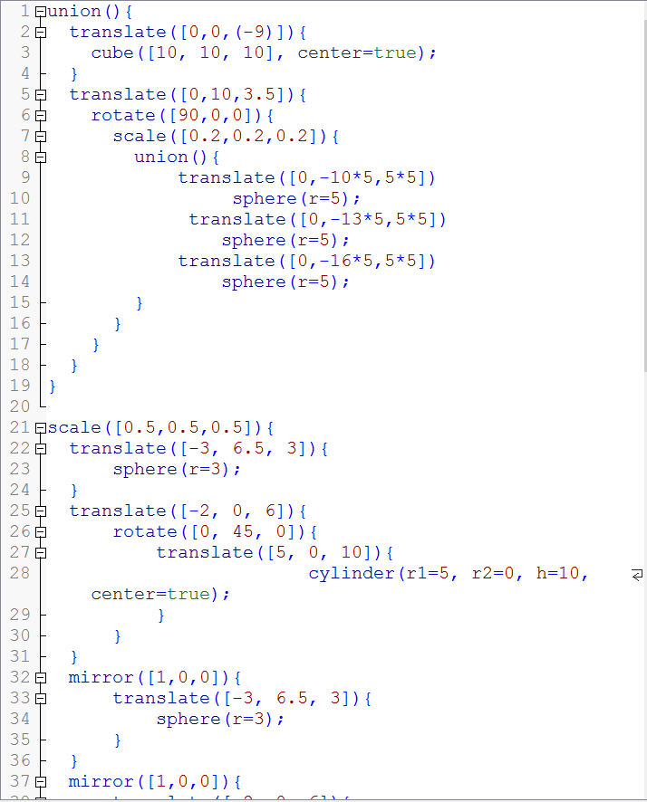
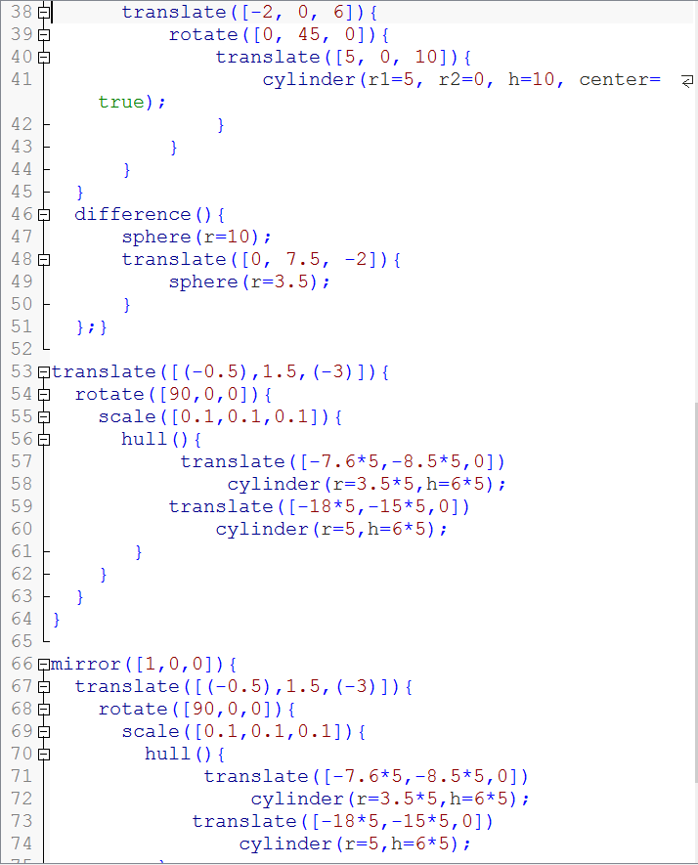
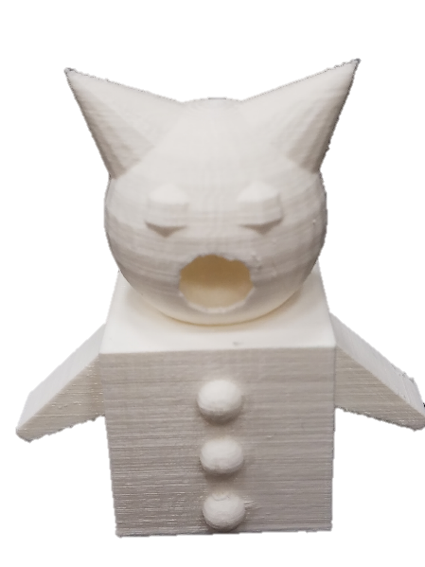
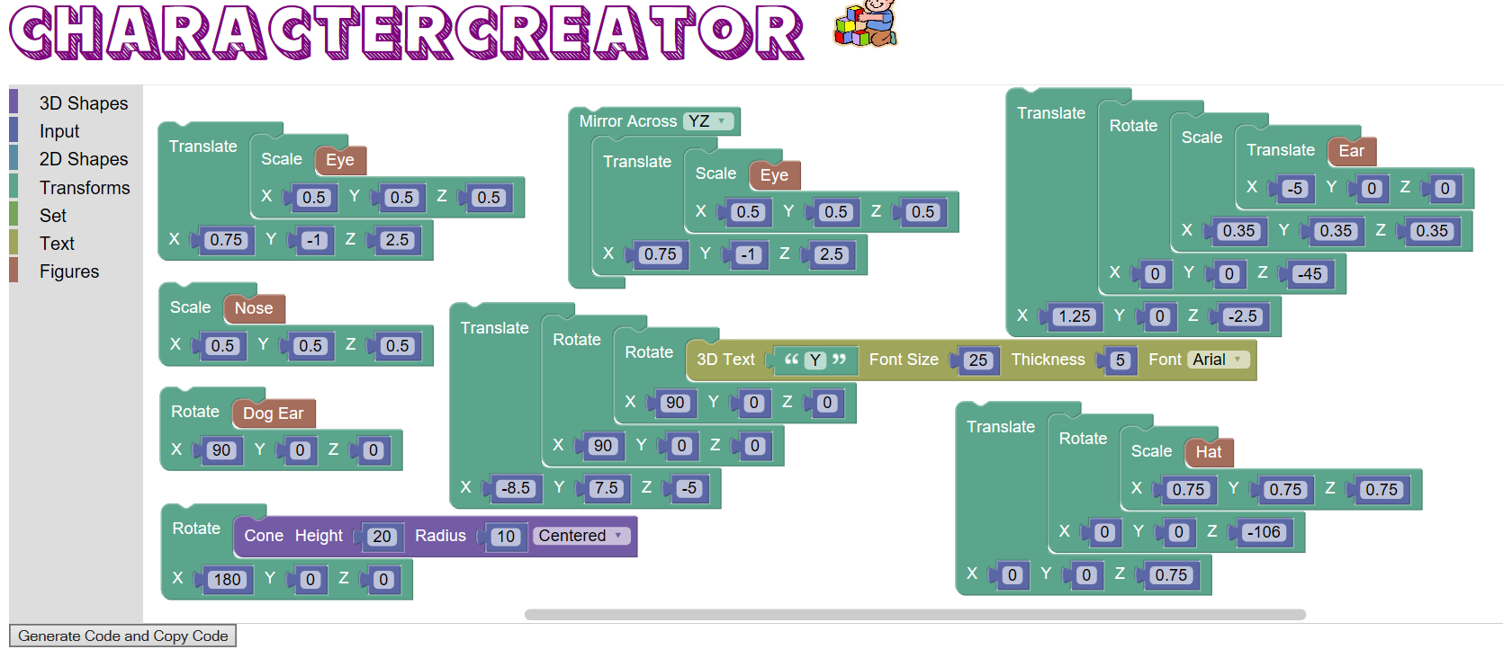
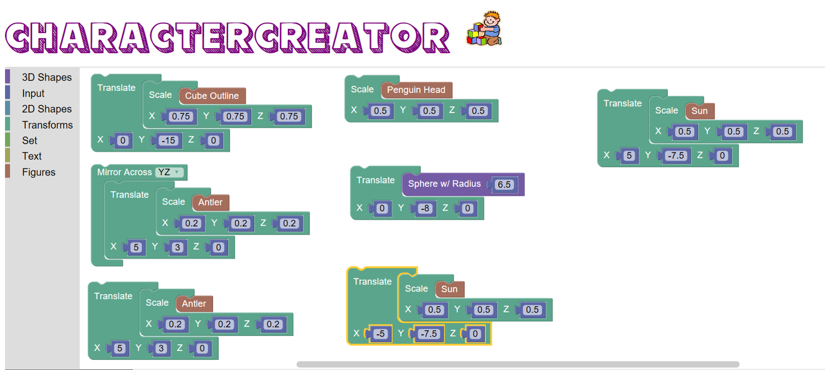
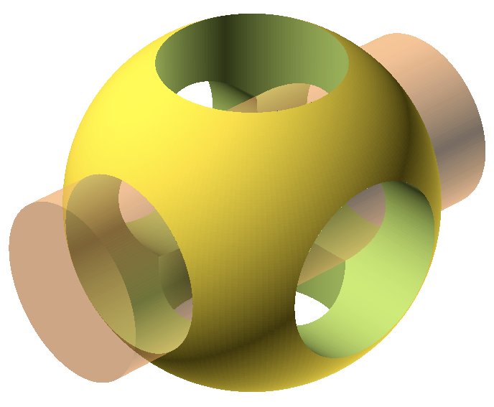
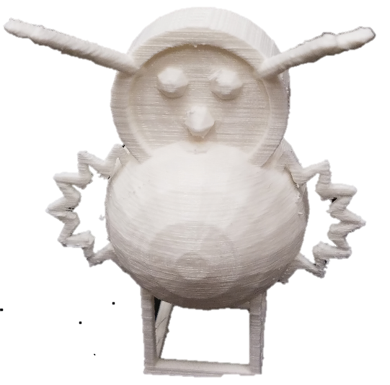
CharacterCreator: An Educational 3D Modeling Application
Abstract
Procedure
Data
Drag-and-drop programming languages, also known as block-based programming languages, are becoming increasingly popular and sophisticated. Many programming environments use a block-based approach, such as Scratch and Alice. The rising prevalence of block-based programming languages is associated with the movement to teach programming to younger learners. Since existing CAD tools require sophisticated programming, a drag-and-drop programming language, CharacterCreator, was developed to create 3D models. CharacterCreator was created using JavaScript, Blockly Developer Tools, and the Atom text editor. Users drag programming blocks into the workspace to design their 3D model and generate OpenSCAD code. The code is put into OpenSCAD and rendered. There are many customized pre-made blocks that create objects at a much higher level of abstraction than OpenSCAD. CharacterCreator makes it easier for users by creating single blocks that consist of multiple blocks allowing the user to create objects more easily. Also, a set of blocks was created for a special figures category. These blocks include a nose, beard, antler, penguin head, etc. These were created so the user could create sophisticated and creative objects using few blocks. Multiple different shapes were created, and the number of blocks used vs. the number of lines of code generated were compared. A t-test was performed comparing the number of blocks to the number of lines of code generated. The difference was statistically significant. CharacterCreator can be useful for beginning programmers. Not only is it easy to use, but it is also faster to code and develop 3D models with this software.
Design
Created a design for how the user interface would look
Decided which blocks to make that generate code for simple OpenSCAD objects, as well as create additional pre-defined blocks for users. These blocks included:
Sphere
Union
Torus (additional block)
Ellipse (additional block)
Decided which figure blocks to create to make my application more fun and engaging for young students. These figures included:
Beard
Nose
Penguin Head
Bear
Coding/Debugging
Most of the time was used for programming and debugging
Learn JavaScript, HTML, and how to use the Blockly developer tools
Created and tested all provided blocks to ensure they work using the Blockly developer tools
Blockly is a library that adds a visual code editor to web and Android apps. The Blockly editor uses interlocking, graphical blocks to represent code concepts like variables, logical expressions, loops, and more. It allows users to apply programming principles without having to worry about syntax or the intimidation of a blinking cursor on the command line.
Coding was done in the Atom text editor using JavaScript and HTML
Testing
To test the program, multiple different blocks were tested using CharacterCreator. The number of blocks used were recorded, as well as the number of lines of code that were generated. A t-test was performed on these to determine if there was a statistical significance in the difference.
Creating a tutorial
A script was written for a tutorial for CharacterCreator users
The tutorial was recorded in which the type of blocks were shown and multiple examples of shapes created were demonstrated
Subtitles, music, and a voiceover were added to complete the tutorial
 | # of Blocks | # of Lines
Sphere | 2 | 1
Cube | 4 | 1
Cylinder | 3 | 1
Cone | 3 | 1
Torus | 5 | 5
Hexnut | 3 | 1
Circle | 2 | 1
Rectangle | 3 | 1
Ellipse | 3 | 3
Equilateral Triangle | 1 | 5
Rhombus | 1 | 6
Cat Head | 1 | 30
Bear | 1 | 42
Fish | 1 | 100
Cube Outline | 1 | 6
Sun | 1 | 20
Antler | 1 | 20
Ear | 1 | 11
Reindeer | 1 | 45
Dog Ear | 1 | 17
 | # of Blocks | # of Lines
Eye | 1 | 6
Nose | 1 | 11
Beard | 1 | 37
Hat | 1 | 36
Penguin Head | 1 | 29
Penguin Buttons | 1 | 8
Penguin Wing | 1 | 6
3d Text | 4 | 3
2d Text | 3 | 1
Translate | 4 | 2
Scale | 4 | 2
Rotate | 4 | 2
Mirror | 1 | 2
Sides | 2 | 2
Rotate Extrude | 2 | 2
Color | 2 | 2
Union | 1 | 2
Intersection | 1 | 2
Difference | 1 | 2
Hull | 1 | 2
As seen by the results, CharacterCreator blocks abstract the number of equivalent OpenSCAD lines that would be needed to create the equivalent character.
Purpose
Conclusion
The goal of this project is to create a drag-and-drop programming language (called CharacterCreator) for 3D printers. This program should be intuitive for users. CharacterCreator should be able to do the basic things that a text based programming language, such as OpenSCAD, would be able to do. CharacterCreator will generate complex, high-level OpenSCAD code. It should be faster to create objects using this drag-and-drop programming language. Writing the code will be quicker which will ultimately make the time spent creating the object less. Also, there will be a category made for figures. These blocks will include things such as animal and human parts that can be mixed and matched. The user will be able to create more sophisticated and creative objects while still using a small number of blocks. The user should be able to open CharacterCreator and easily code complex objects with many parts without needing assistance.
The data obtained throughout this research project supports the claim that CharacterCreator is much more efficient and easy to use than text-based languages such as OpenSCAD. CharacterCreator makes it fun to program and create 3D models, and adds excitement to computer science for young/new programmers.
CharacterCreator
Future Research
Future research would include creating more blocks within CharacterCreator. There would be more figures for users to select and use to create characters. This would allow users to create more complex blocks with CharacterCreator. In addition, the objects created would be able to be rendered on the CharacterCreator screen. This would make CharacterCreator more efficient, for the user would be able to see what they have created immediately.
Using CharacterCreator, blocks were used to create the code for the model. After the blocks were made OpenSCAD code was generated as seen in the middle. This OpenSCAD code rendered a 3D model of what the printed object would look like. The model was then printed as shown.
Sources
Materials
Begel, A. (1996, May 24). LogoBlocks: A Graphical Programming Language for Interacting with the World [Scholarly project]. Retrieved August 06, 2016, from http://research.microsoft.com/en-us/um/people/abegel/mit/begel-aup.pdf
DiSalvo, B. (2014, November/December). Graphical Qualities of Educational Technology (G. Domik & S. Owen, Eds.) [Scholarly project]. Retrieved July 25, 2016, from http://betsydisalvo.com/wp-content/uploads/2015/01/DiSalvoIEEECGA.pdf
Gray, J., Bau, D., Kelleher, C., Sheldon, J., & Turbak, F. (n.d.). Learnable Programming: Blocks and Beyond [Scholarly project]. Retrieved July 01, 2016.
Meerbaun-Salant, O., Armoni, M., & Ben-Ari, M. (n.d.). Learning Computer Science Concepts with Scratch [Scholarly project]. Retrieved August 01, 2016, from http://ims.mii.lt/ims/konferenciju_medziaga/ICER'10/docs/p69.pdf
Weintrop, D., & Wlinesky, U. (2015). To Block or not to Block, That is the Question: Students’ Perceptions of Blocks-based Programming [Scholarly project]. Retrieved August 01, 2016, from http://ccl.northwestern.edu/2014/Weintrop and Wilensky - 2015 - To Block or Not to Block, That is the Question St.pdf
Atom Text Editor
Blockly Developer Tools
Windows 10 Computer
OpenSCAD 3D Modeling Software
As shown here, in CharacterCreator blocks were used to create the 3D model on the right. The equivalent number of lines of code to create this model using OpenSCAD would be 134 lines.
As shown here, in CharacterCreator blocks were used to create the 3D model on the right. The equivalent number of lines of code to create this model using OpenSCAD would be 123 lines.

