Slide 1
Project Overview
Thumbnail: | A statewide professional development model based on the Master Teacher paradigm is implemented and evaluated across 50 teachers over three years.
Institutions/ PI/Leads | University of Alabama (Jeff Gray) A+ College Ready – NMSI (Mary Boehm)
PD Locations | Tuscaloosa/Birmingham, AL Future: 6 weeks online |  | Districts: |  | Statewide
Teachers
# teaching CSP/ # in PD | 2013-2014: 9 teachers 2014-2015: 23 teachers 2015-2016: 20 teachers | Background / prior experience |  | In-Service: Year 1: Taught rigorous CS course in past Year 2-3: Mix of STEM teachers Pre-service: 3 hour course at UA for Math Secondary Education majors
Grade(s): | 9th-12th grades
Supported by NSF Award #1240944

Slide 2
Professional Development Characteristics
PD dosage and format: | Online-summer: 40 hours over 6 weeks (Years 2/3); content knowledge F2F-summer: 30 hours; pedagogical content knowledge; CS Principles Lesson Plans and Syllabi; Performance Task discussions F2F-school year: 12 hours; 2 weekend sessions over school year Online-school year: 20 hours; bi-weekly Hangouts; biweekly assessment
Versions | Above is for in-service teachers. For pre-service teachers, the new non-majors course counts as the required CS course for Secondary MathEd majors.
Formats | Master Teacher concept In-person for pedagogy Online for content knowledge Online for frequent school year interaction Sharing of lesson plans on Community of Practice | Stipends & Goodies | $3800 over year; split into two payments $2800 equipment allowance Travel coverage for summer PD, weekend PD, and SIGCSE
Supported by NSF Award #1240944

Slide 3
Master Teacher Summary
The initial 9 instructors have the following characteristics:
An average of 18 years teaching grades K-12, ranging from 6-30 years
An average of 12 years teaching computer science at the HS level, ranging from 3-22 years
All instructors have at least a Master’s degree; one teacher has a Ph.D. in CS
Most instructors have taken at least 30 hours of PD in computer science or CS education in the last three years
8 of 9 instructors are the only CS instructors at their schools
Teacher-driven lesson plans provided on Community of Practice
Supported by NSF Award #1240944

Slide 4
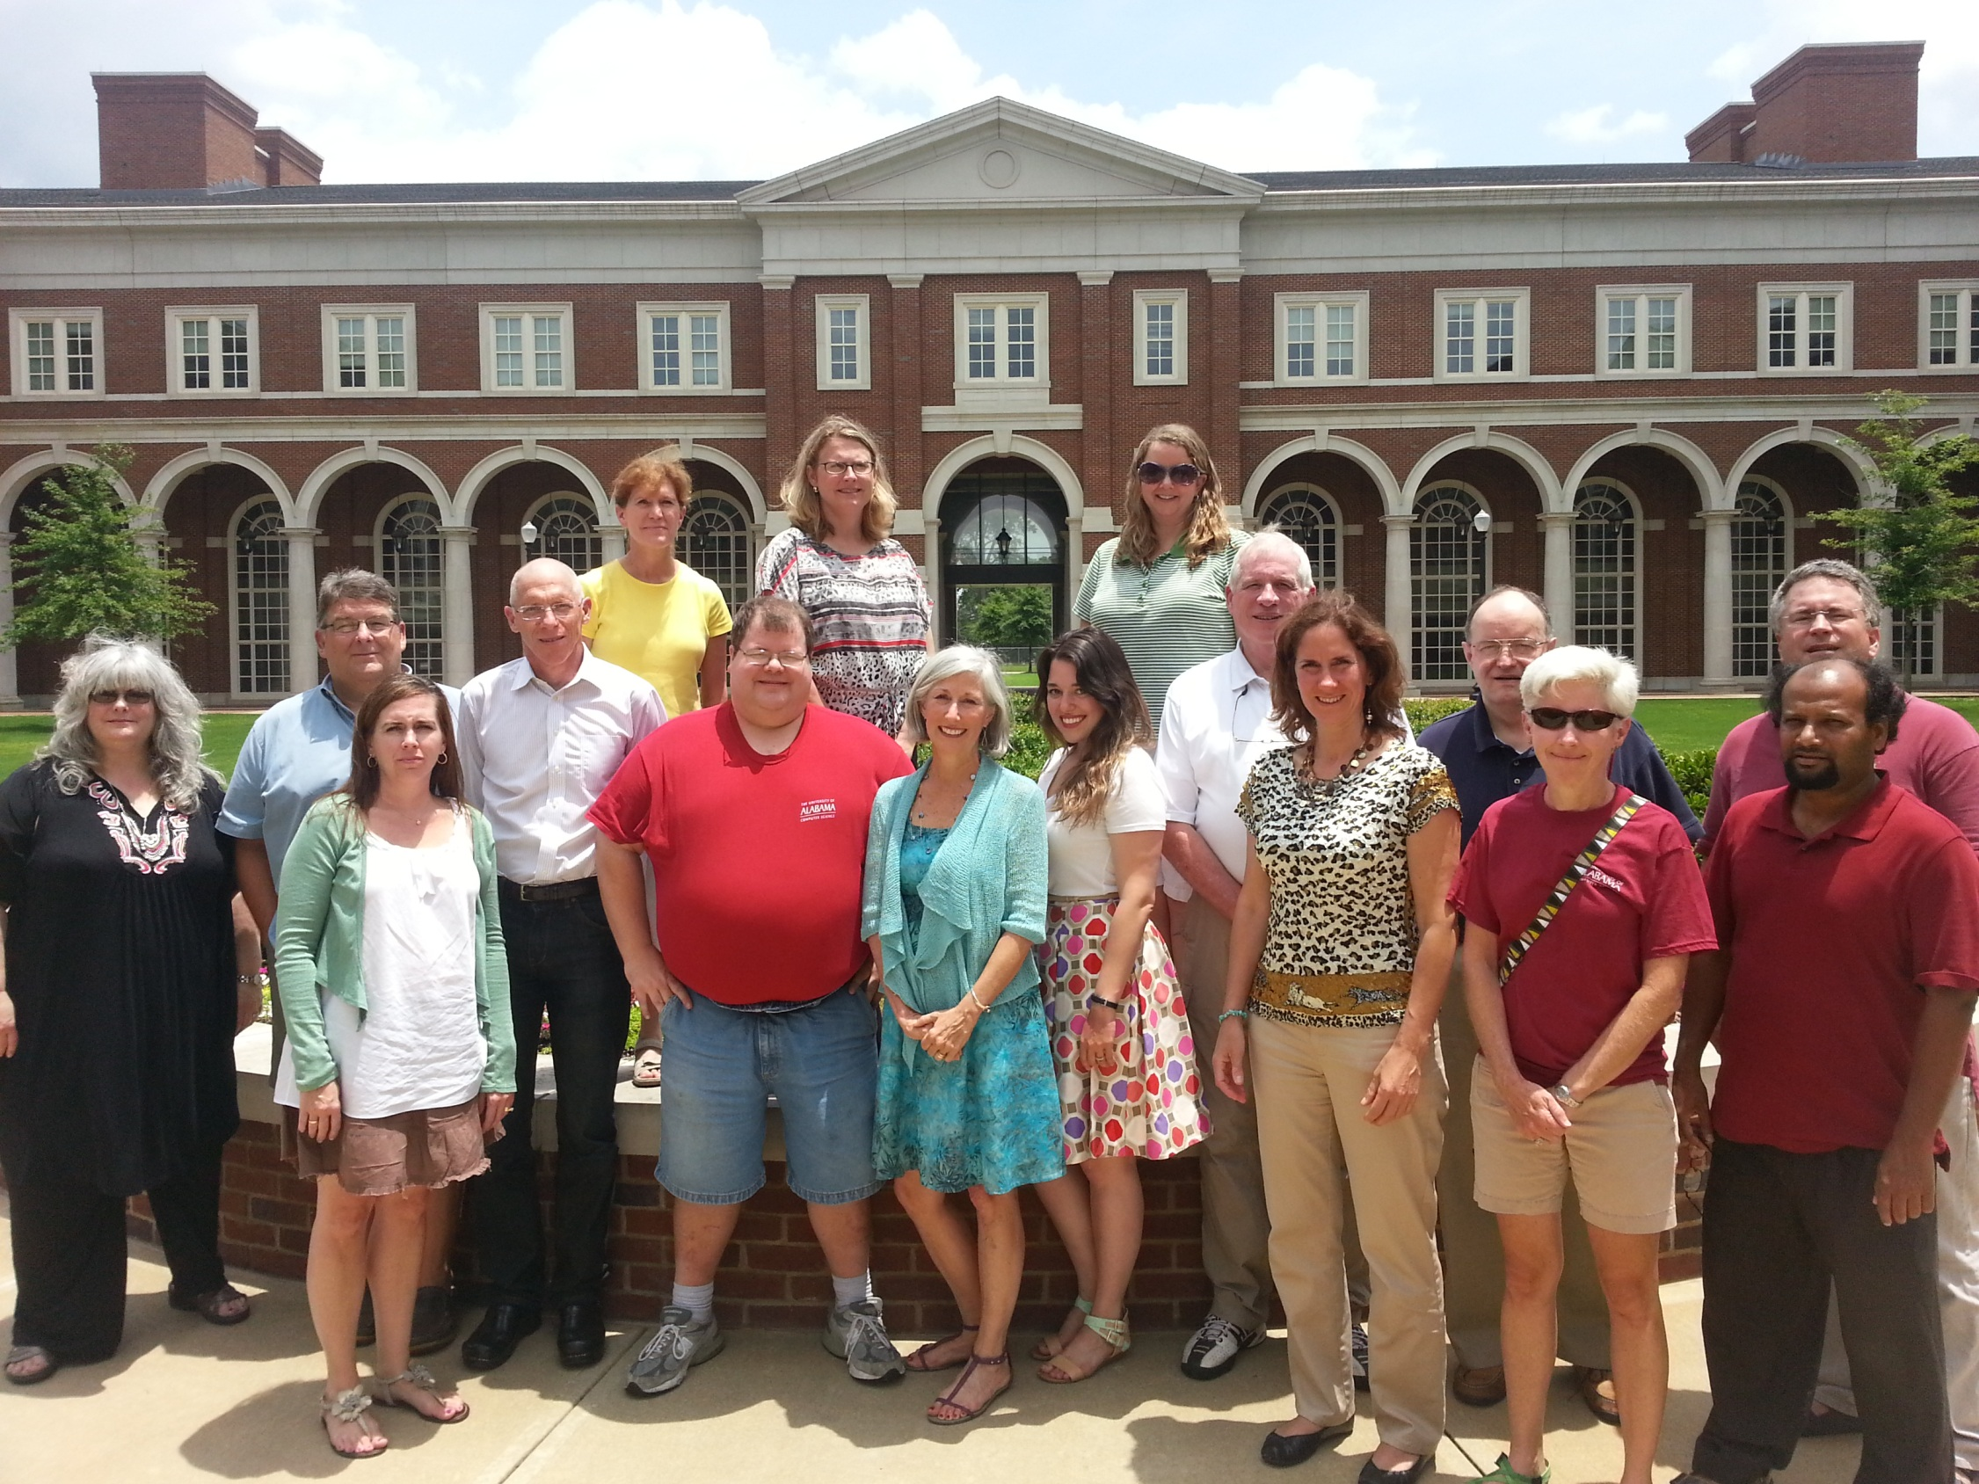

Slide 5
Highlights
Milestone dates
January 2013: CS Principles official statewide course code
June 2013: Alabama CSTA chapter formed
December 2013: CS Principles and CS A counts as formal math elective for HS graduation
Student enrollment
268 students across 9 schools
46% of students were either female or from an underrepresented minority
Diversity expected to be much higher in Years 2 and 3
National Teacher achievements
Teacher-driven lesson plans provided on Community of Practice
3 of 9 teachers are national Pilot teachers (Gina, Jill, Carol)
Gina McCarley featured in Forbes Magazine for Samsung winner with an App Inventor project
Carol Yarbrough invited speaker at CSTA/Google CS Principles workshop
All teachers on SIGCSE poster (presented right now, by them!)
Supported by NSF Award #1240944

Slide 6
Highlights
Over 60% of students in pre-service course were women or underrepresented minority
Benefits of deep assessment
Multiple pre/post surveys of both teachers and students
Student enrollment data
Biweekly surveys on recent course instruction topics
Common Assessment created by teachers
Provided information to adapt PD needs as they emerged across the year (e.g., challenges in technical writing instruction)
Project has forged many new national collaborations and sharing
Supported by NSF Award #1240944

Slide 7
Key Lessons Learned
Importance of building deep connections among teacher “family”
Connections to guidance counselors crucial
Some counselors used the new course as a class to place students with deep remediation needs
See NCWIT Counselors for Computing web page
9th graders not suitable candidates, in most cases
The main challenge is the technical writing needs of performance tasks
This will be AP rigor; very few 9th graders take other AP exams
Statewide advocacy with State Department of Ed thrived with the energy created by this course across communities
Principals that formerly would not return emails are now coming to us and wanting to be in our next cohort
Pre-service collaboration with MathEd department much easier than expected (please introduce CSP at your school and give it a try!)
Supported by NSF Award #1240944

Slide 8
Key Lessons Learned
Formal contract with teachers and Principals
Application requires teachers AND Principals to write essays describing why they want to be participants
Detailed outline of expectations and incentives; marathon experience!
Teacher PD must also be differentiated!
Big Data and Investigate task needed the most discussion during PD, followed by the Internet (and Explore) tasks
Collaboration with NMSI partner (A+ College Ready) deeply beneficial for recruitment and advocacy
Connection “hotline” to ALSDE Superintendent
Already existing partnerships with over 100 high schools to help with teacher recruitment
Key for sustainability and scalability
Supported by NSF Award #1240944

Slide 9
Remaining Challenges
Moving from Year 1 to Year 2
The deeper experience of the Master Teachers, to those with less experience
Main project change related to the observation that deeper summer PD needed; led to plans for online 6-week addition
Challenges in scaling mentoring relationship (e.g., subgroups and bi-weekly Hangouts a possible option)
Encouraging teachers to post on Community of Practice
Vetting of materials within group before posting more broadly
University course: too few contact hours
Too much of a rush for a 3-hour course to cover all of CSP LOs
Inability to enforce fidelity of courses offered with the approved state code, who are not in our project team
Supported by NSF Award #1240944

