Slide 1
Measuring BPC Results in Alabama
2018 Annual ECEP Meeting
January 26, 2018 - Atlanta, GA
Jeff Gray, Professor
Department of Computer Science, University of Alabama
gray@cs.ua.edu
With thanks to:
ALSDE: Dawn Morison and Dr. Barbara Cooper
A+ College Ready: Tammy Dunn
Tuskegee University: Dr. Mohammed Qazi
Bumpus Middle School: Vinny Chiaramonte

Slide 2
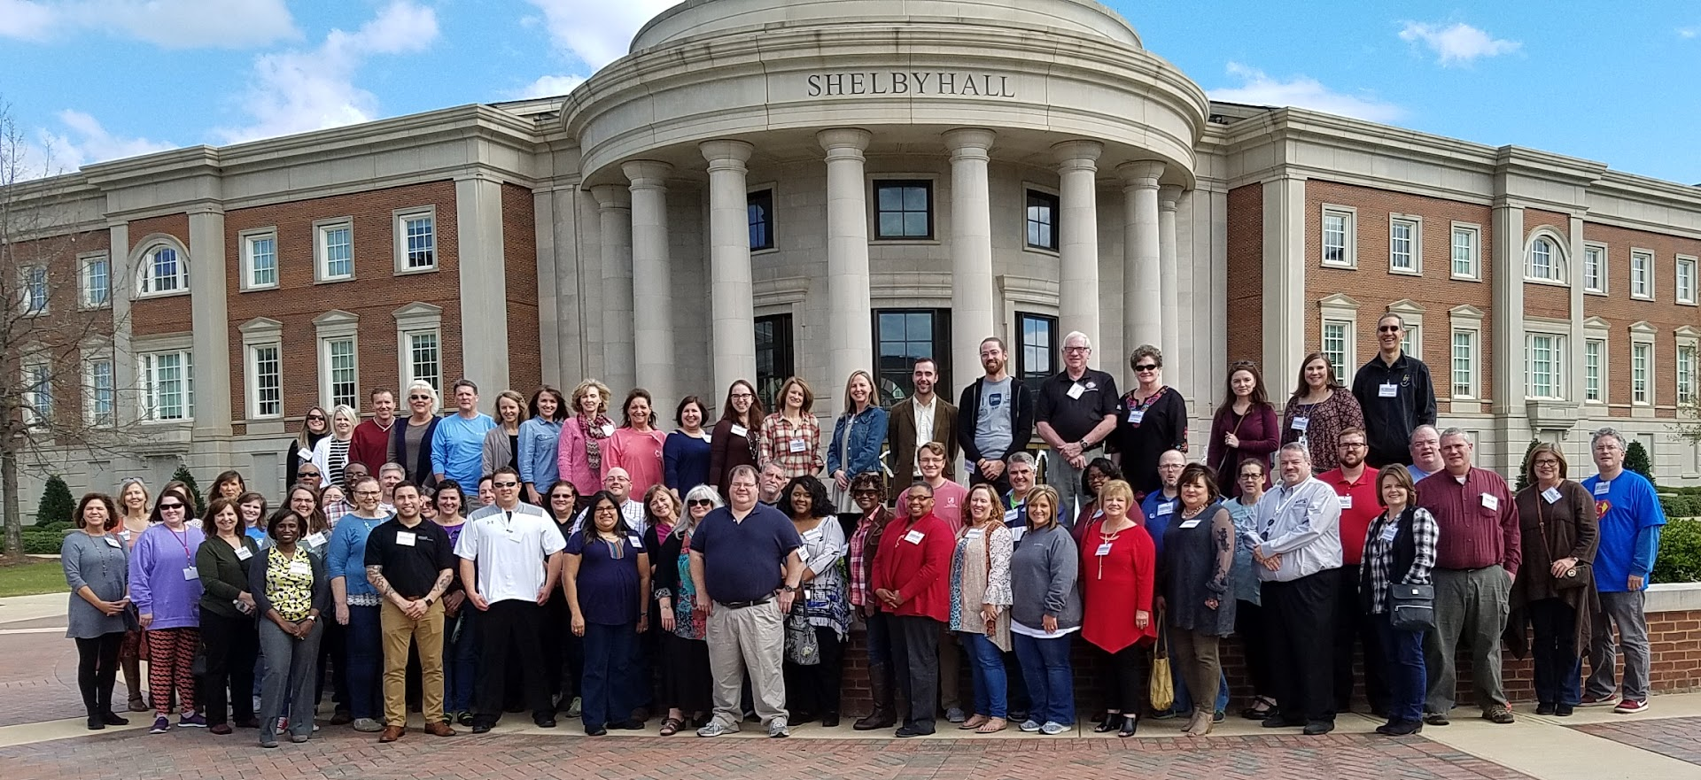

Slide 3
How Alabama Defines and Measures BPC
BPC Defined by
Gender
URM status :
African American
Alaskan Natives
American Indians
Asian
Poverty and SES (ALSDE)
Students with disabilities (ALSDE)
Exceptionalities
Special Education
BPC Measured by
Informal Teacher Self-Reporting
College Board AP CS scores
NSF Project Reports
ALSDE Detailed Course Enrollments
Participation among CS Leaders

Slide 4
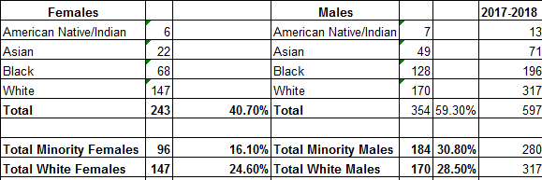
Informal – Teacher Self-Reporting
Bumpus Middle School – Code.org CS Discoveries
Disadvantages
Manually intensive to collect
Distributed potential for error

Slide 5
College Board for AP CS Exam Scores
2007
2017
Disadvantages
Only tracks exam takers, not all student enrollment
Disability or special needs students
 | Total Exams | Female | African-American | Other URM
AP CS A | 27 | 3 (11%) | 3 (11%) | 0
 | Total Exams | Female | URM | % Qualify for AP Credit
AP CSP | 1249 | 408 (33%) | 342 (27%) | 65%
AP CS A | 271 | 55 (20%) | 81 (30%) | 52%

Slide 6
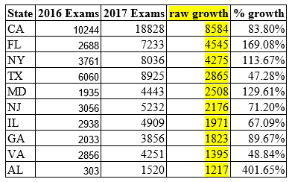
From 2007 to 2017, and 2016 to 2017
Alabama 10th in Nation in overall growth
(top-9 more heavily populated)
Alabama 3rd in Nation in % growth

Slide 7
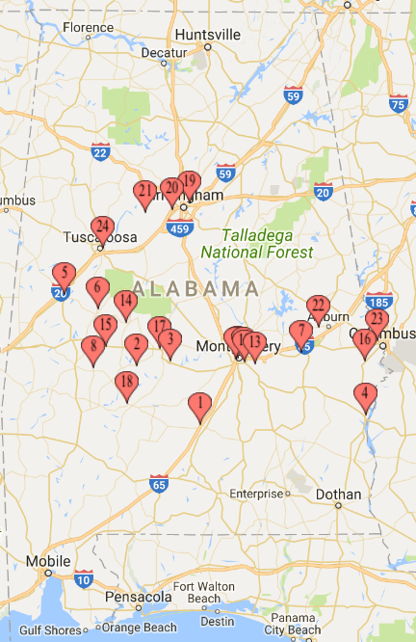
NSF Projects – Tuskegee ECS Project
Recruit and prepare 60 high school teachers over 3 years in two cohorts and prepare 2,500 students with ECS in Alabama’s Black Belt
1 teacher per high school
Total Students: 556
Total Female Students: 264 (47%)
Total URM: 414 (74%)
Advantage
More confidence on fidelity of course offering
Disadvantage
Does not reflect total ECS enrollment across state
ALSDE reports 786 students; NSF project reports 556

Slide 8
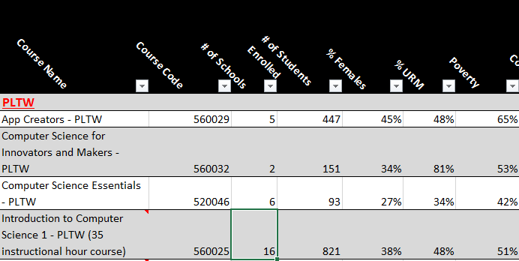
AL State Department of Education (ALSDE)
Query capability for all course codes across gender, URM identification, SES, and (limited) disabilities/special needs
Disadvantage
Tracking fidelity to course description across large state footprint

Slide 9
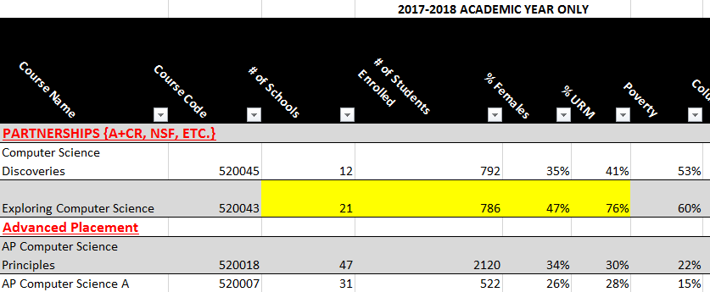
AL State Department of Education (ALSDE)

Slide 10
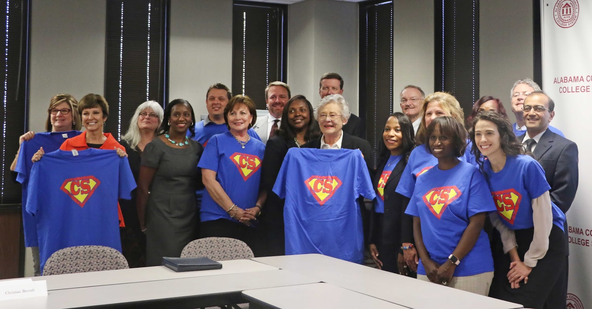
Measuring BPC Among Educators and Leaders
Governor Kay Ivey’s CS Advisory Council
Formed in October; ECEP Summit
20 members; 11 women (6 URM women)
ALSDE CS Standards Committee
Just completed this week after 11 months
24 members; 15 women
Teacher Leaders
AP CSP: Two leaders, both women, one African American
ECS: 24 teachers; 74% women, 78% URM
CS Discoveries: 1 of 2 leaders is female

Slide 11
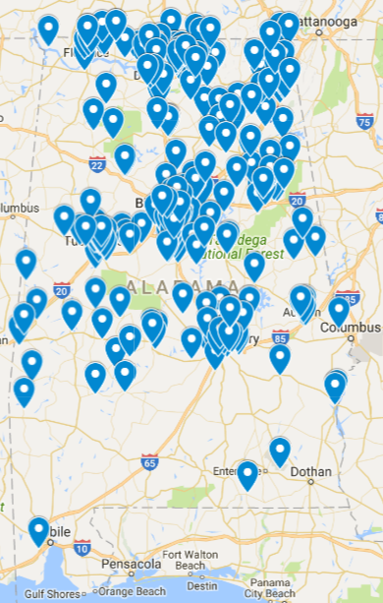
Core Challenges in Measuring BPC
K5 coverage of CS
How many total schools and classrooms within each school?
How many hours per year of CS content?
Exceptionalities and Special Education Needs
Coarse-grained, only reported within these two categories
Finer-grained data available, but requires special permission requests
Fidelity of course curricula
Anyone may add a course and deviate from the description
Are students really learning CS or something else?

Slide 12
Exceptionalities
A student who has an exceptionality has some area of functioning in which he or she is significantly different from an established norm. This definition includes both students with disabilities and those with special gifts or talents. Types of exceptionalities include: learning disabilities; developmental delays; emotional and behavioral disorders; communication disorders; hearing disabilities; visual impairments; and physical disabilities.

Slide 13
Special Education
Special education services are very personalized and depend upon the “need” of the student. It could be as simple as a seat cushion to assist with “sensory” issues in younger children or voice recognition software for students unable to manipulate a keyboard/mouse. Also includes access to other services such as speech therapy, physical therapy, occupational therapy, an aide, etc.

