Slide 1
The Adjustable Grid: A Grid-Based Cursor Control Solution using Speech Recognition
Tarif Haque, Emily Liang, Jeff Gray
Department of Computer Science
Notes:
Hi, my name is Tarif Haque and I’m an undergraduate studying Computer Science at the University of Alabama. Today I will be giving a talk on a voice controlled cursor control solution myself, my research partner Emily Liang, and my adviser Dr. Jeff Gray studied. We call it the Adjustable Grid.

Slide 2
Overview
Accessibility concerns & motor disabilities.
Speech-based cursor control systems.
Approaches and problems with existing solutions.
Grid-Based Cursor Control.
The Adjustable Grid.
Experimenting with the Adjustable Grid.
Future Work: Extending the Adjustable Grid.
Demonstration.
Notes:
Before we talk about the Adjustable Grid, it’s important to address a preliminary motivation. Mouse control has become a necessity in most modern computer interactions and when traditional user interfaces are designed, the requirements of motor impaired users can often be overlooked.

Slide 3
Motor Disabilities & Information Accessibility
Mouse control is a necessity in many computer interactions, particularly WIMP style interfaces.
The unique requirements for motor impaired users can often be overlooked.
Notes:
Before we talk about the Adjustable Grid, it’s important to address a preliminary motivation. Mouse control has become a necessity in most modern computer interactions and when traditional user interfaces are designed, the requirements of motor impaired users can often be overlooked.

Slide 4
Motor Impairments
A loss or abnormality of body structure or function
May be caused by a variety of conditions:
Cerebral Palsy
Parkinson’s Disease
Spinal Injury
Partial Paralysis
Arthritis
Stroke
Notes:
A motor impairment can be defined as a loss or abnormality of body structure or function. This may include a loss of muscle power, reduced joint mobility, uncontrolled muscle activity (like tremors), or the absence of a limb, either literal or psychological. In our context, we are interested in those impairments that reduce an individual’s ability to manipulate a traditional mouse and keyboard.

Slide 5
A Solution
Hands-free, speech-based systems provide an alternative to mouse-centered navigation.
Notes:
A hands-free, speech based system provides an alternative to mouse-based cursor control. As we will see some systems have already been developed. Inexpensive and require no external equipment to facilitate

Slide 6
Speech-Based Control Systems
Currently on the market:
Dragon Naturally Speaking
Windows Speech Recognition
Notes:
Currently, there are two main Speech-based control systems on the market: Dragon Naturally Speaking and Windows Speech Recognition.

Slide 7
A Comprehensive Speech Control System for Personal Computers
Cursor Control
[Mouse Replacement]
Not as naturally mapped to speech.
Text Entry
[Keyboard Replacement]
Target-based solutions
Direction-based solutions
Near perfect accuracy
Notes:
A Comprehensive Speech Control system must give the user the a mouse and keyboard replacement. Replacing a keyboard with speech is very natural, and existing speech recognition software, like Dragon Naturally Speaking, has near-perfect dictation accuracy.
Cursor control, on the other hand, is not as naturally mapped to speech as dictation. Dictation involves converting speech to text, which is then displayed, while cursor control involves a visual aspect on top of speech recognition. So, it requires another mechanism in order to facilitate it. Within the realm of speech-based systems, cursor control solutions have diverged into two main mechanisms: target-based solutions and direction-based solutions, which we will discuss in further detail.

Slide 8
Direction-Based Systems
Discrete:
Mouse ‘listens’ to directional commands with a defined unit size
OR
Continuous:
Cursor moves in direction specified until command ‘Stop’ is recognized
Notes:
Direction-based systems involve a dependence on the cursor’s current location. The two means of directional cursor movement are discrete and continuous. In the discrete approach, the mouse ‘listens’ to directional commands with a defined distance of movement, for example 2 inches or 5 centimeters, and moves the cursor accordingly. With the continuous approach, the user specifies the desired direction, and the cursor moves in that direction until a ‘stop’ command is recognized.

Slide 9
Direction-Based Systems
‘Down 4’
‘Left 7’
‘Down’
‘STOP’
Notes:
Direction-based systems involve a dependence on the cursor’s current location. The two means of directional cursor movement are discrete and continuous. In the discrete approach, the mouse ‘listens’ to directional commands with a defined distance of movement, for example 2 inches or 5 centimeters, and moves the cursor accordingly. With the continuous approach, the user specifies the desired direction, and the cursor moves in that direction until a ‘stop’ command is recognized.

Slide 10
Problems with Direction–Based Systems
Discrete approach:
Less effective as distance between cursor and target increases
Continuous approach – 3 types of delay
Perception of cursor reaching target
Utterance of ‘Stop’ command
Processing of command

Slide 11
Target-Based Systems
Research Focus: Grid-Based Systems
Standardized: majority use 3 x 3 granularity
“Granularity” – extent of grid divisions
Recursive selection strategy
Notes:
Unlike direction based systems, a grid based system moves the cursor to specific location on the screen and it is not dependent on the previous location of the cursor. To date, many of these grids have a standardized 3 x 3 grid. The “granularity” – or the extent of the grid divisions – has remained more or less the same.

Slide 12
Grid-Based Target Selection
1 | 2 | 3
4 | 5 | 6
7 | 8 | 9
1 | 2 | 3
4 | 5 | 6
7 | 8 | 9
1 | 2 | 3
4 | 5 | 6
7 | 8 | 9
Notes:
Unlike direction based systems, a grid based system moves the cursor to specific location on the screen and it is not dependent on the previous location of the cursor. To date, many of these grids have a standardized 3 x 3 grid. The “granularity” – or the extent of the grid divisions – has remained more or less the same.

Slide 13
Adjustable Grid
We developed a grid of adjustable granularity on start-up.
> User specifies the grid dimensions.
Notes:
T: Because the literature does not appear to touch on the subject of varying granularities, we implemented a grid of adjustable granularity on start-up in which the user specifies the grid-size they’d like to use.

Slide 14
Adjustable Grid
1 | 2 | 3 | 4
5 | 6 | 7 | 8
9 | 10 | 11 | 12
13 | 14 | 15 | 16
1 | 2 | 3 | 4 | 5 | 6 | 7 | 8 | 9 | 10
11 | 12 | 13 | 14 | 15 | 16 | 17 | 18 | 19 | 20
21 | 22 | 23 | 24 | 25 | 26 | 27 | 28 | 29 | 30
31 | 32 | 33 | 34 | 35 | 36 | 37 | 38 | 39 | 40
41 | 42 | 43 | 44 | 45 | 46 | 47 | 48 | 49 | 50
51 | 52 | 53 | 54 | 55 | 56 | 57 | 58 | 59 | 60
61 | 62 | 63 | 64 | 65 | 66 | 67 | 68 | 69 | 70
71 | 72 | 73 | 74 | 75 | 76 | 77 | 78 | 79 | 80
81 | 82 | 83 | 84 | 85 | 86 | 87 | 88 | 89 | 90
91 | 92 | 93 | 94 | 95 | 96 | 97 | 98 | 99 | 100
1 | 2
3 | 4
1 | 2 | 3
4 | 5 | 6
7 | 8 | 9
Notes:
T: Because the literature does not appear to touch on the subject of varying granularities, we implemented a grid of adjustable granularity on start-up in which the user specifies the grid-size they’d like to use.

Slide 15
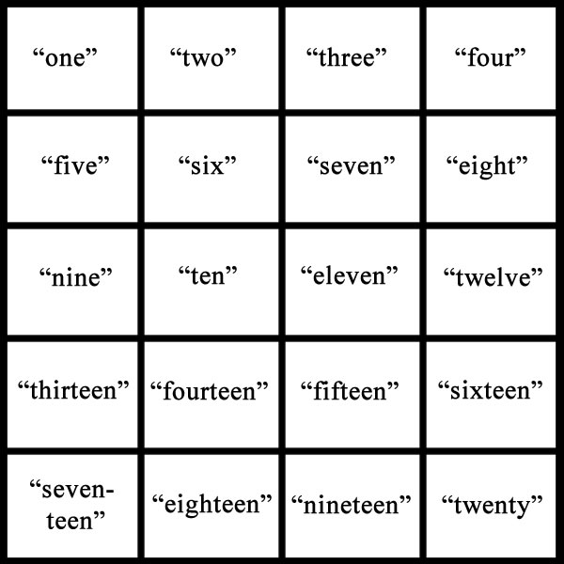
Dynamic Grammar Generation
Generating the speech grammar of a 4x5 grid.
Notes:
The Adjustable Grid generates a grammar for each individual grid dynamically. If the user says “4” then “5” during the selection prompts, a 4x5 grid is painted on the screen. Generating the vocabulary after the grid has been specified maximizes performance for each individual grid by limiting the number of speech commands that can be spoken and thereby reducing speech recognition errors.

Slide 16
Research Motivation
No comparisons among grids of differing granularities.
Highly standardized granularity: 3 x 3.
> Reduced flexibility with only a single default grid.

Slide 17
Experimentation
Two members of our research team tested each grid with a 5-target selection protocol.
Recorded total time to complete the target selection, number of speech recognition errors, and number of commands issued.
Notes:
To our knowledge, no previous research compares grids of differing granularities for speech-based cursor control. Two comparison-based studies were designed and performed by the research team.
- The first study evaluated the performance of pure-resolution grids (e.g. 2x2, 3x3, 4x4) against one another.
The second study sought to investigate the potential of mixed resolution grids (e.g. 4x3) by comparing a 4x3 grid to the standard 3x3 grid.
Our experimentation was informal!

Slide 18
Pure-Resolution Grid Comparisons
Table 1. Summarized Pure Grid Performance on Machine I
 | 2x2 | 3x3 | 4x4 | 5x5 | 6x6
Time | 26.69 (2.12) | 25.76 (9.85) | 28.65 (5.81) | 19.96 (6.14) | 18.87 (2.74)
Commands | 13.0 (0.00) | 10.40 (2.07) | 12.60 (2.19) | 10.0 (2.92) | 8.60 (1.34)
Errors | 0.20 (0.45) | 2.80 (2.95) | 1.40 (0.89) | 1.00 (1.73) | 0.20 (0.45)
Table 2. Summarized Pure Grid Performance on Machine II
 | 2x2 | 3x3 | 4x4 | 5x5 | 6x6
Time | 30.00 (1.06) | 19.04 (1.23) | 28.56 (8.42) | 20.79 (2.04) | 22.63 (4.07)
Commands | 13.40 (0.89) | 8.80 (0.45) | 10.60 (2.50) | 8.80 (0.45) | 8.00 (0.71)
Errors | 0.20 (0.45) | 0.20 (0.45) | 1.00 (1.41) | 0.00 (0.00) | 0.20 (0.45)
Notes:
Our results suggest an improvement for 5x5 and 6x6 pure-resolution grids. The 3x3 grid performed well on Machine 2, but not as well on Machine 1. The 5x5 and 6x6 grids, however, consistently performed well across both machines. Even with their increased vocabulary size, the 5x5 and 6x6 grids appear to work as well, if not better, than the 3x3 grid.
Across the experiments, the relatively high standard deviations for selection time suggest existing speech recognition tools continue to be unreliable. The 2x2 grid, with a small vocabulary of four words, appeared to be the only grid that consistently performed at error-free levels.

Slide 19
Mixed-Resolution Grid Comparisons
Table 3. Mixed-Resolution Grid vs. Pure-Resolution Grid
 | 4x3 [PC I] | 4x3 [PC II] | 3x3 [PC I] | 3x3 [PC II]
Time | 16.44 (1.29) | 19.53 (1.2) | 25.76 (9.85) | 19.04 (1.23)
Commands | 9.4 (0.55) | 8.4 (0.89) | 10.40 (2.07) | 8.80 (0.45)
Errors | 0.00 (0.00) | 0.40 (0.55) | 2.80 (2.95) | 0.20 (0.45)
Notes:
Our findings show clear potential for mixed-resolution grids. The 4x3 grid performed better, if not as well, as the 3x3 grid on multiple machines. On Machine I, the 4x3 grid performed significantly better than the 3x3 grid, with a 36% improvement in completion time at error-free levels. In addition, the low standard deviations of the 4x3 grid measurements compared to the 3x3 grid shed light on the grid’s reliability.

Slide 20
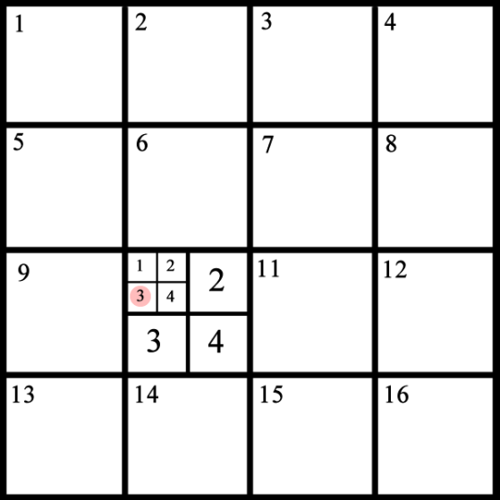
Future Work: Extending the Grid
A grid of two differing granularities may aid with fine-tuning target selection.
- Larger initial granularity.
- Reduced granularity for subsequent drilling.
Notes:
A solution using two different granularities.
A 4x4 grid is used for the initial overlay.
A 2x2 grid is used for subsequent drilling.

Slide 21
Demonstration

Slide 22
Conclusions
SR Tools continue to have trouble detecting singular utterances out of context.
We suggest future systems focus less on the singular 3x3 grid and rather take a dynamic, adjustable approach, an implementation that grants increased flexibility.
As user interfaces become more expansive and demanding, relying on a single grid may be limiting to users.

Slide 23
Related Work
Zhu, S., Feng J., Sears, A. (2010). Investigating Grid-Based Navigation: The Impact of Physical Disability. ACM Transactions on Accessible Computing.
Dai, L., et. al. (2004). Speech-Based Cursor Control: A Study of Grid-Based Solutions. ASSETS ‘04.

Slide 24
Questions?
Acknowledgements
Emily Liang, Undergraduate Research Partner
Jeff Gray, Adviser
This research was made possible by The University of Alabama and the National Science Foundation.

Slide 25
Alternative Cursor-Control Technology
Head movement tracking
Tongue-operated joystick
Eye-tracking
These systems often require expensive external equipment whereas speech-based systems rely only on the standard microphone.

Slide 26
Speech Recognition
Words
Words
Subwords
(Syllables)
Utterance
+
Silence
Phone
(Sound)
Phone
(Sound)
Fillers
Waveform
Notes:
To explain how speech recognition works, we must first understand what speech actually is.
When we think of speech, we think of words being made of subwords, like syllables, which in turn are built from phones, or sounds. In actuality, speech is much more dynamic and much less discrete. When we speak, we don’t usually pause between each word or syllable. So, what is actually detected is a waveform, a graphic representation of the sound wave.
The recognizer takes this waveform, splits it into utterances by detecting silences, and then tries to recognize what’s being said in each utterance. When Sphinx detects a number being said, our system moves the cursor to that number on the grid.

Slide 27
Speech Recognition
Acoustic model – contains acoustic properties for each phone, including context-independent models and context-dependent ones
Phonetic dictionary – contains a mapping of words to phones
Language model – restricts word search

